Slide 1
Data and development: Why are we building Our World in Data?

Slide 2
What is Our World in Data?

Slide 3
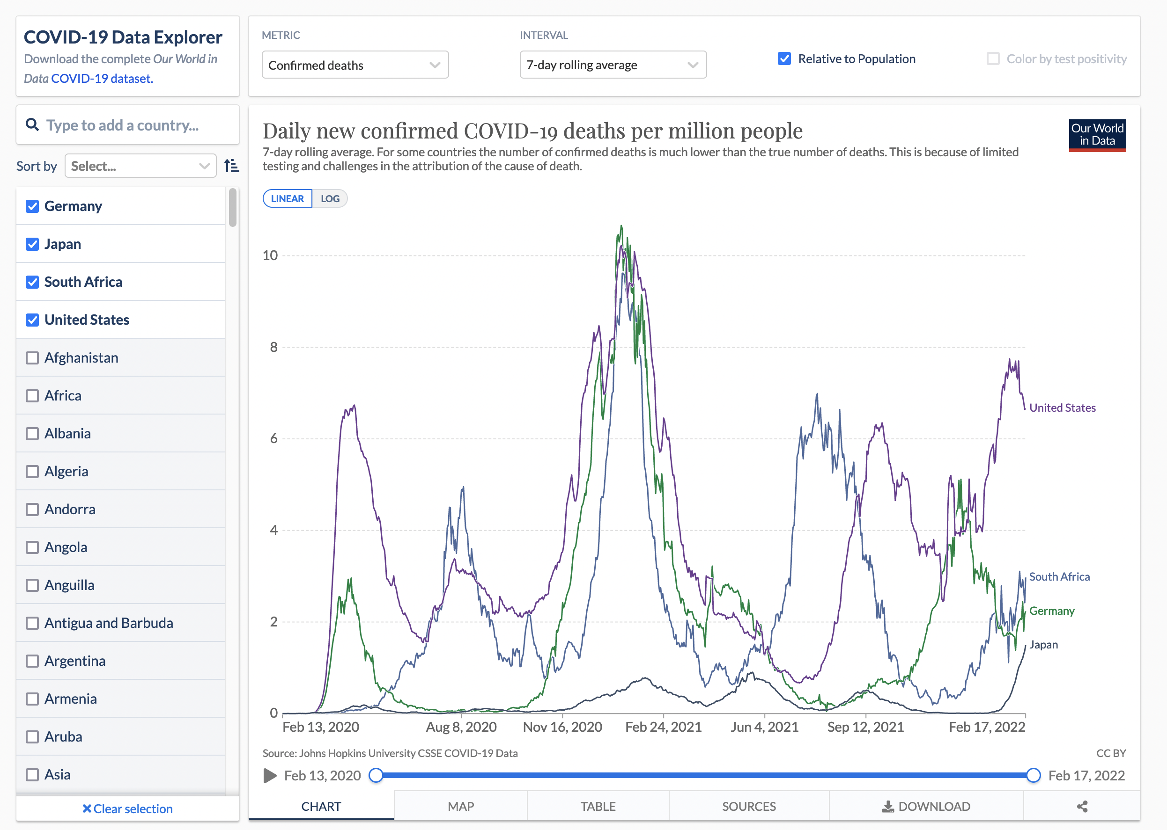
Next slide: embed with the Explorer open on deaths and switch to the global vaccination data
https://ourworldindata.org/explorers/coronavirus-data-explorer?facet=none&Metric=Confirmed+deaths&Interval=7-day+rolling+average&Relative+to+Population=true&Color+by+test+positivity=false&country=USA~ZAF~DEU~JPN

Slide 4
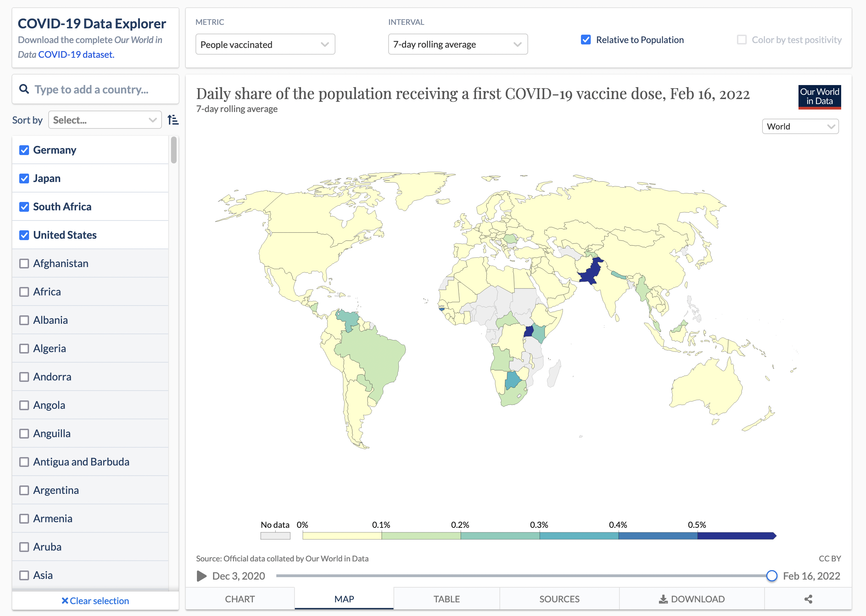
https://ourworldindata.org/explorers/coronavirus-data-explorer?tab=map&facet=none&Metric=People+vaccinated&Interval=7-day+rolling+average&Relative+to+Population=true&Color+by+test+positivity=false&country=USA~ZAF~DEU~JPN

Slide 5
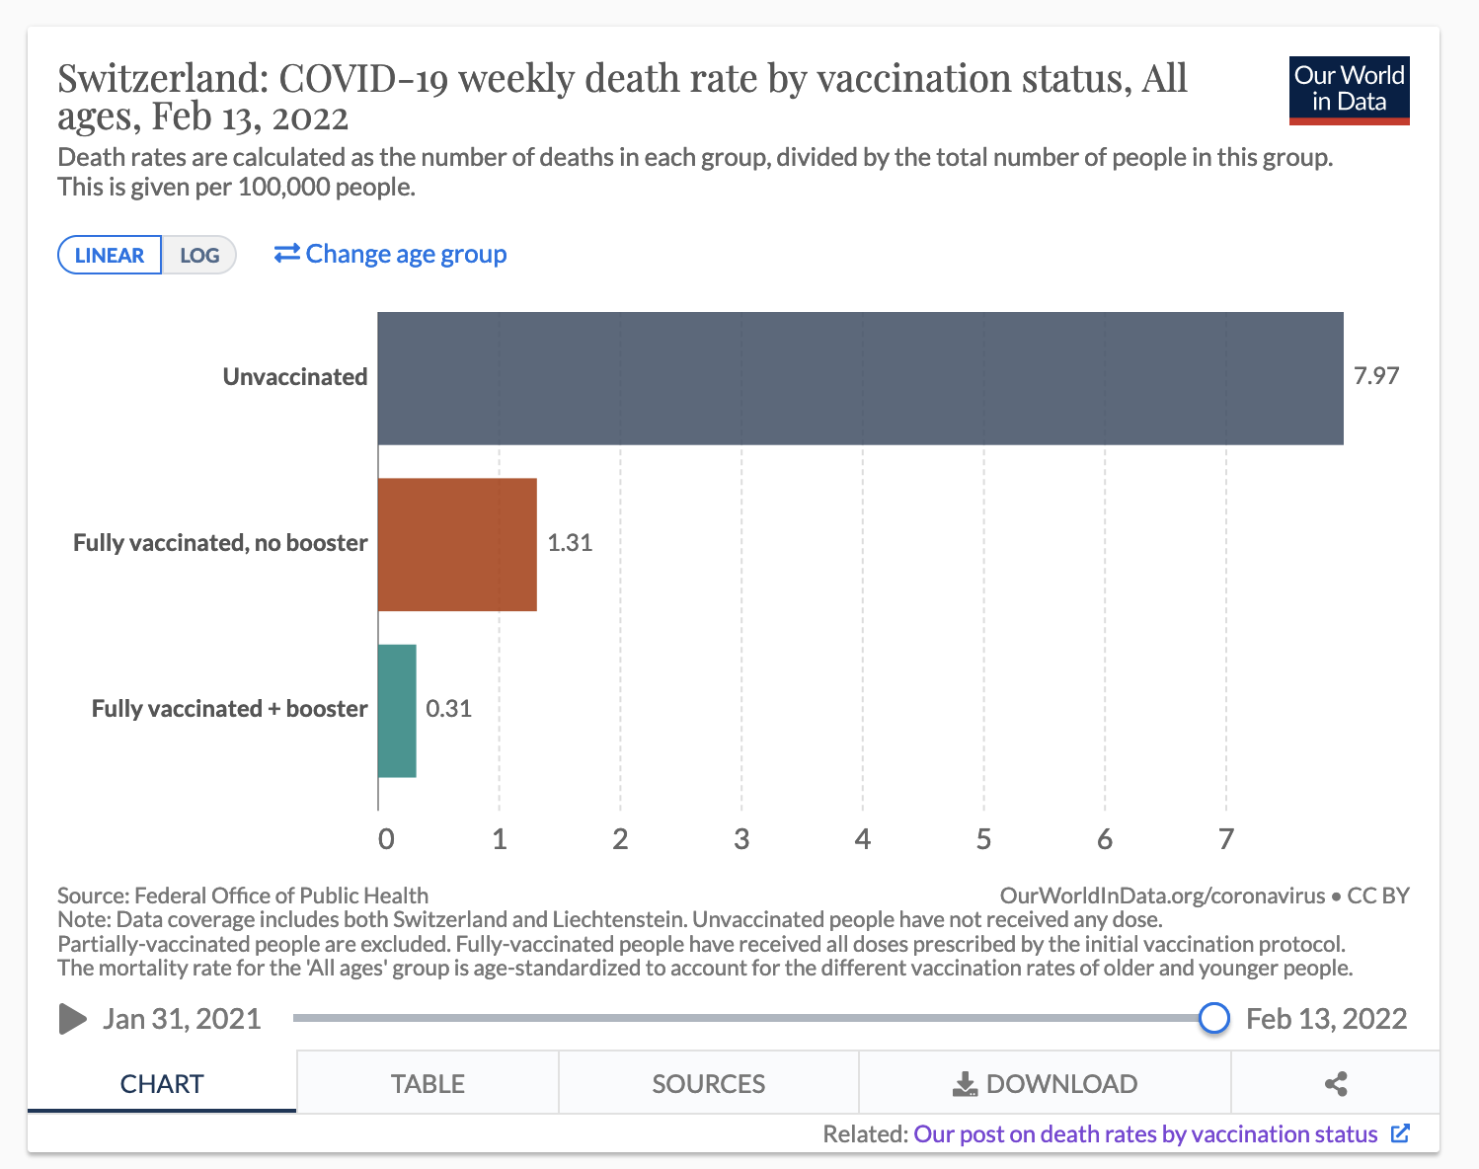
https://ourworldindata.org/covid-deaths-by-vaccination
Following slide: embed the post on outcomes by vaccination status

Slide 6
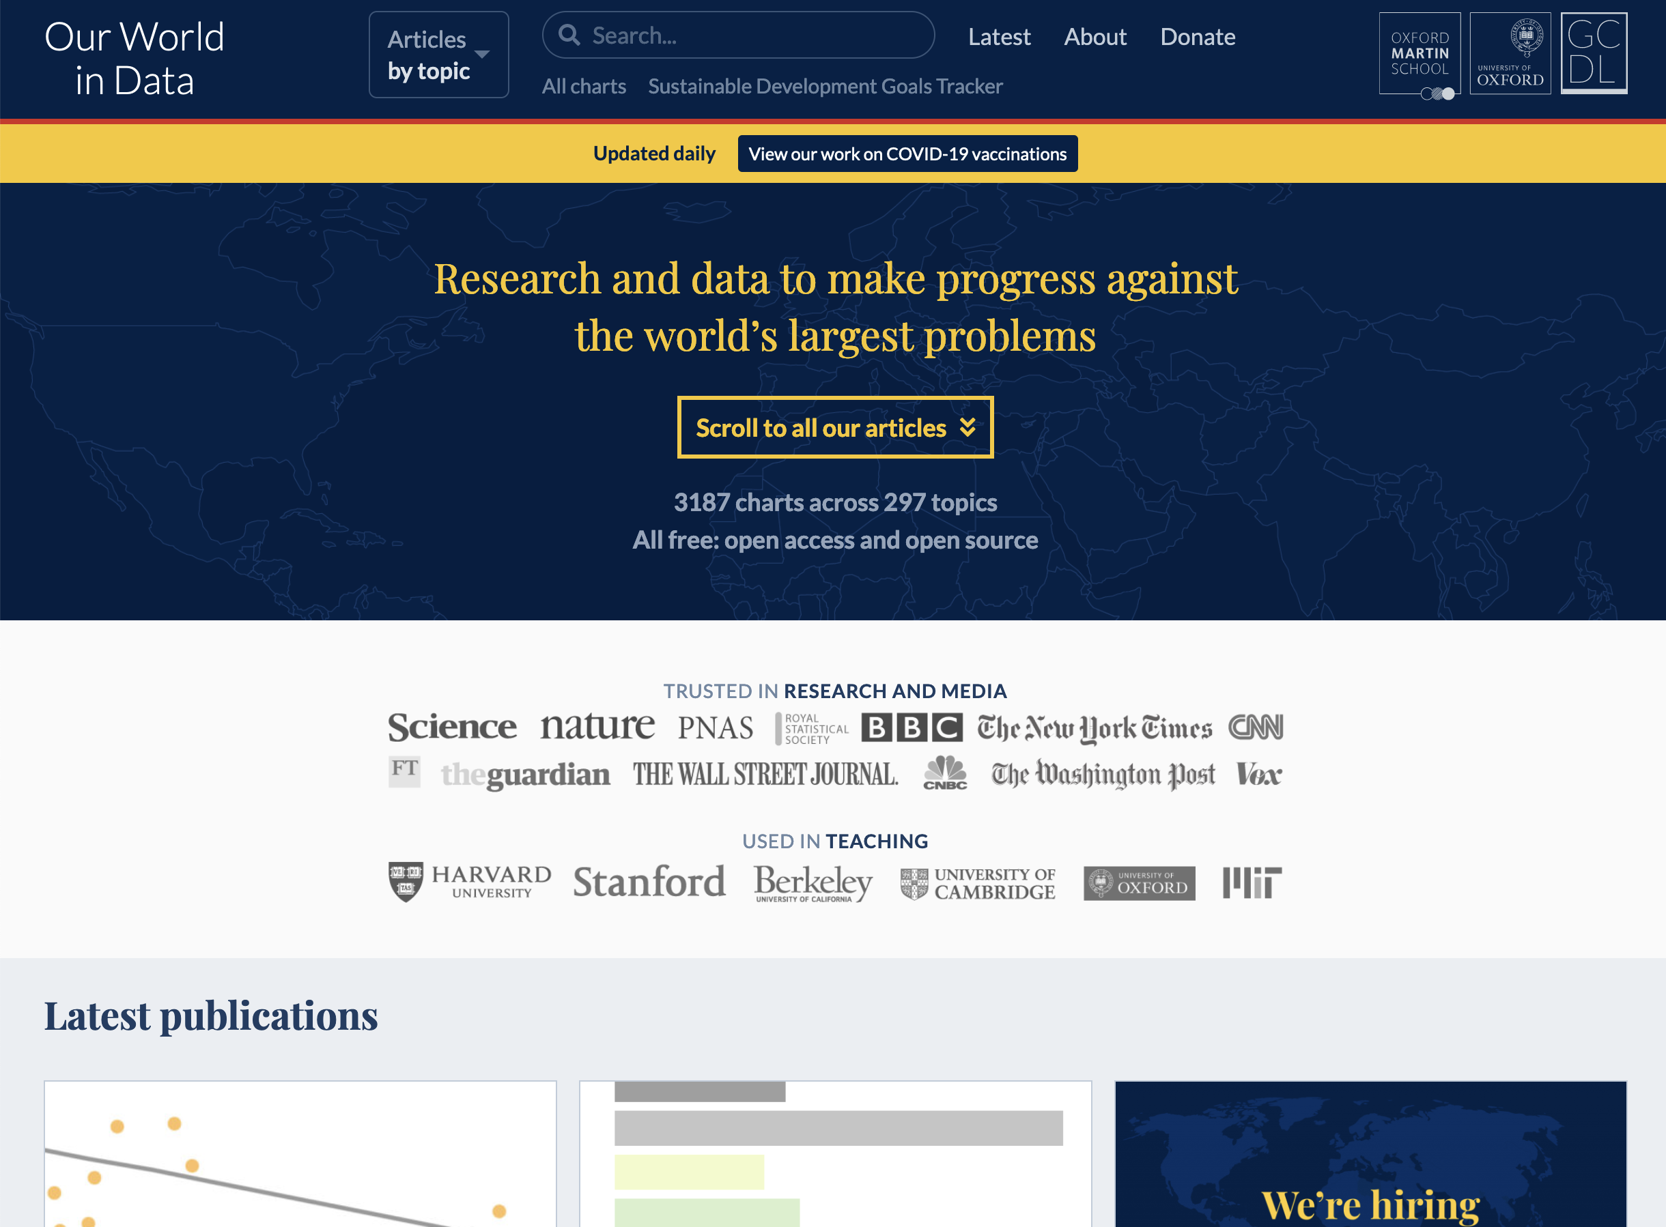
Following slide: show the landing page https://ourworldindata.org/

Slide 7
What do you need to know to make the world a better place?
That it is possible to make the world a better place.
What the world’s biggest problems are.
How to make progress.

Slide 8
What do you need to know to make the world a better place?
That it is possible to make the world a better place
→ The world is better
What the world’s biggest problems are
→ The world is awful
How to make progress.
→ The world can get better

Slide 9
1] What are the world’s biggest problems?

Slide 10
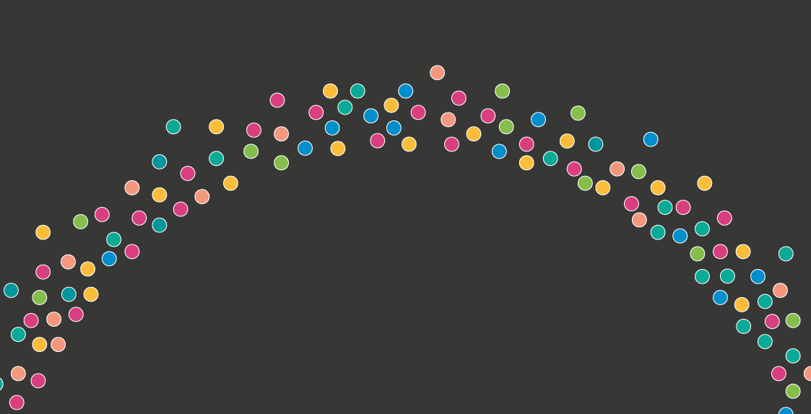

Slide 11


Slide 12
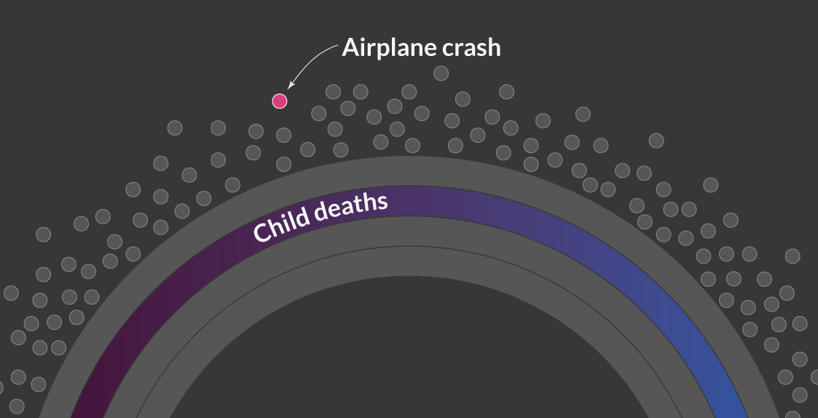
14,000 child deaths
14,000/583=24
Every hour of every day a plane crashes

Slide 13
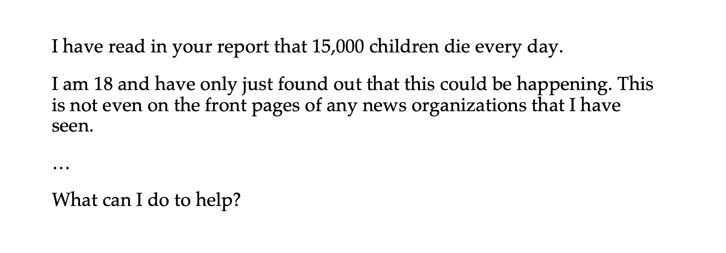
Many of these large problems don’t receive attention

Slide 15
Global Problems of the Decade
This one shows the quickly estimated decadal averages or sums
Millions of newborns lost their mother in the moment they were born
Billions live in poverty
Maternal deaths: In the last decade 4 million women died from pregnancy-related causes globally.
Poverty: The majority of the world – 65% – lives on less than $10 per day.
Perhaps leave this out
Hundreds of millions don’t have access to basic resources
Millions of children grew up with the chance to go to school
Lack of access to basic infrastructure: 700 million in the world do not have access to clean drinking water, 1.1 billion don’t have access to electricity
Lack of access to education: 60 million children of primary school age are not in school.
Perhaps leave this out
World destroyed forests the size of Sweden
60 million children dead
Environmental destruction: The world deforested 47 million hectares of forest in the last decade, that’s an area the size of Sweden.
Child deaths: In the last decade 4.5% (or so) of all children died before they were five years old.

Slide 16
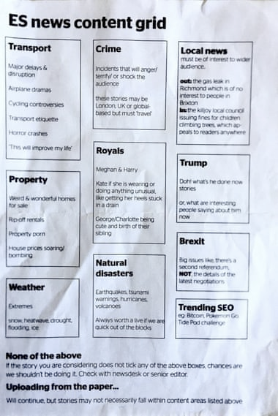

Slide 17
Global Problems of the Decade
This one shows the quickly estimated decadal averages or sums
Millions of newborns lost their mother in the moment they were born
Billions live in poverty
In the last decade 4 million women died from pregnancy-related causes.
Currently 830 mothers die on any average day.
The majority of the world – 65% – lives on less than $10 per day.
And almost 10% live in ‘extreme poverty’, they live on less than $1.90 per day.
One in four lives in dictatorship
Millions of children grew up with the chance to go to school
Almost a quarter of the world population – 23% – live in autocratic regimes.
60 million children of primary school age are not in school.
Hundreds of millions don’t have access to basic resources
700 million do not have access to clean drinking water, 1.1 billion don’t have access to electricity
World destroyed forests the size of Sweden
60 million children dead
The world deforested 47 million hectares of forest in the last decade, that’s an area the size of Sweden.
In the last decade 4.5% (or so) of all children died before they were five years old.

Slide 18
2] Do people know that it is possible to make the world a better place?

Slide 19
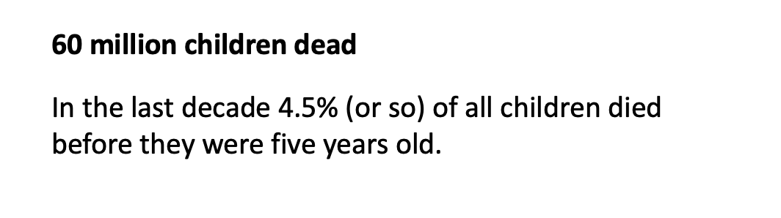

Slide 20
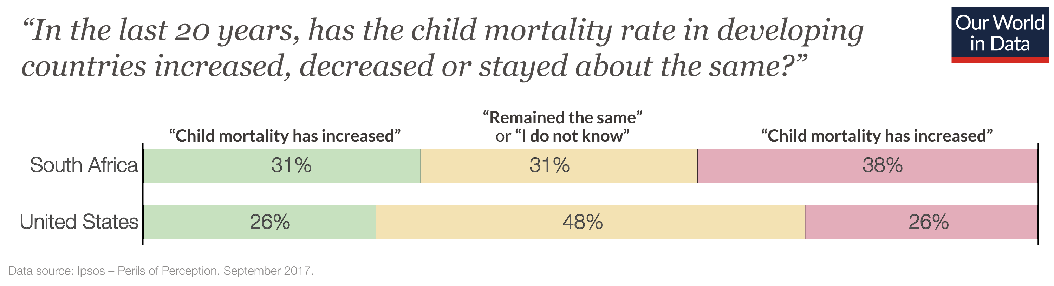

Slide 21
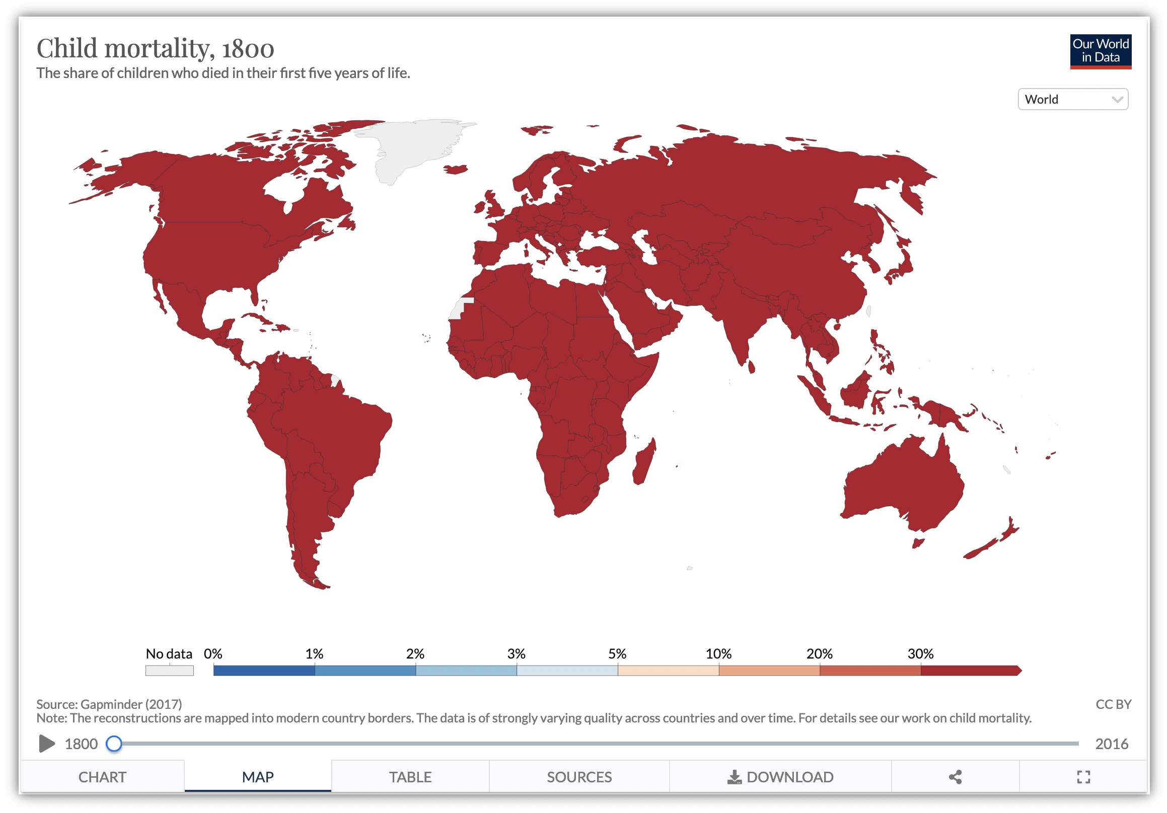
https://ourworldindata.org/grapher/child-mortality-complete-gapminder?time=1800

Slide 22
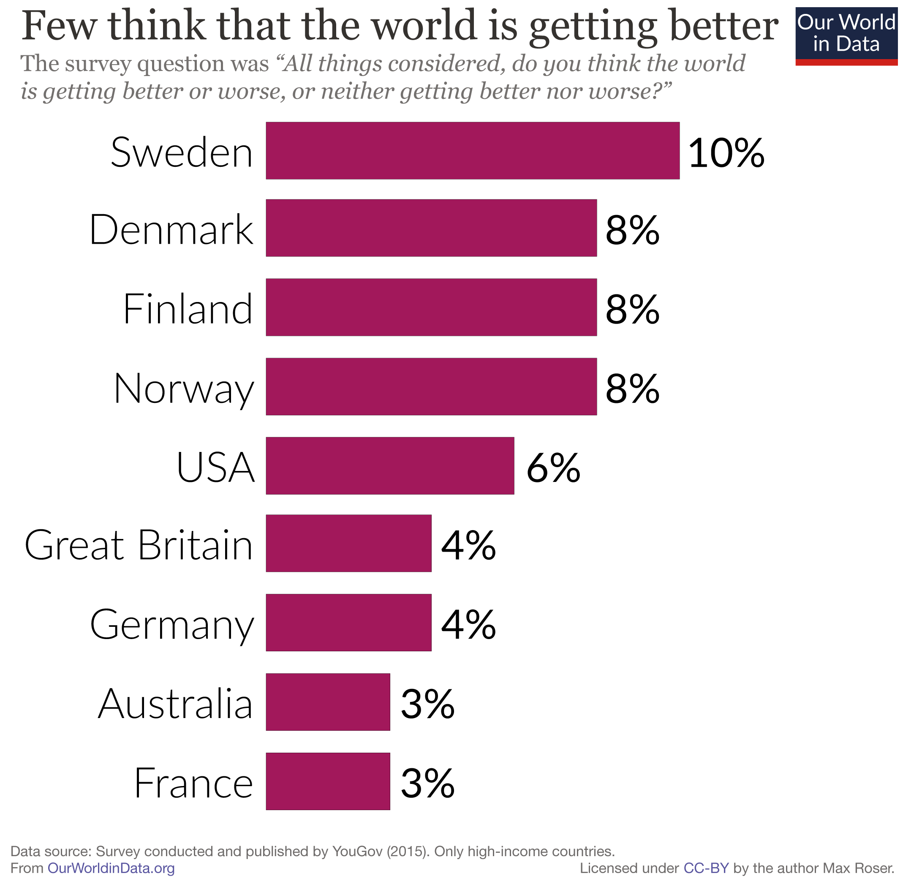

Slide 23
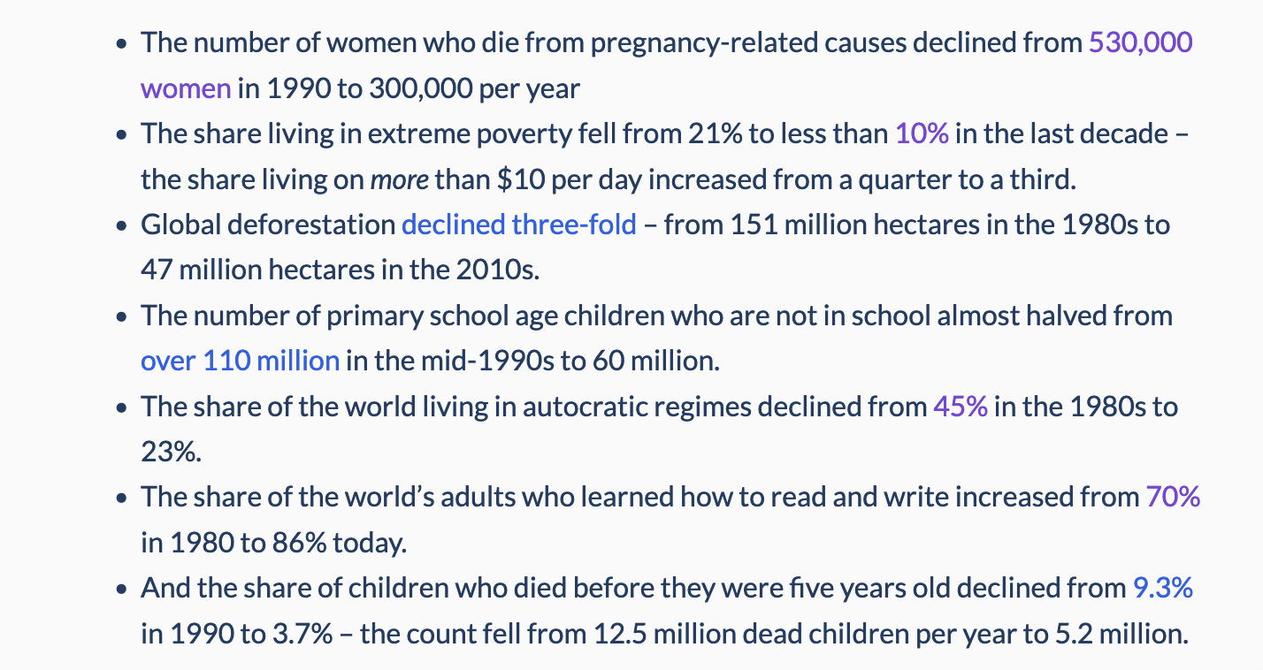
Is progress against child mortality an exception?
To do: Turn this into a chart

Slide 24
Why do only few people know that progress is possible?

Slide 25
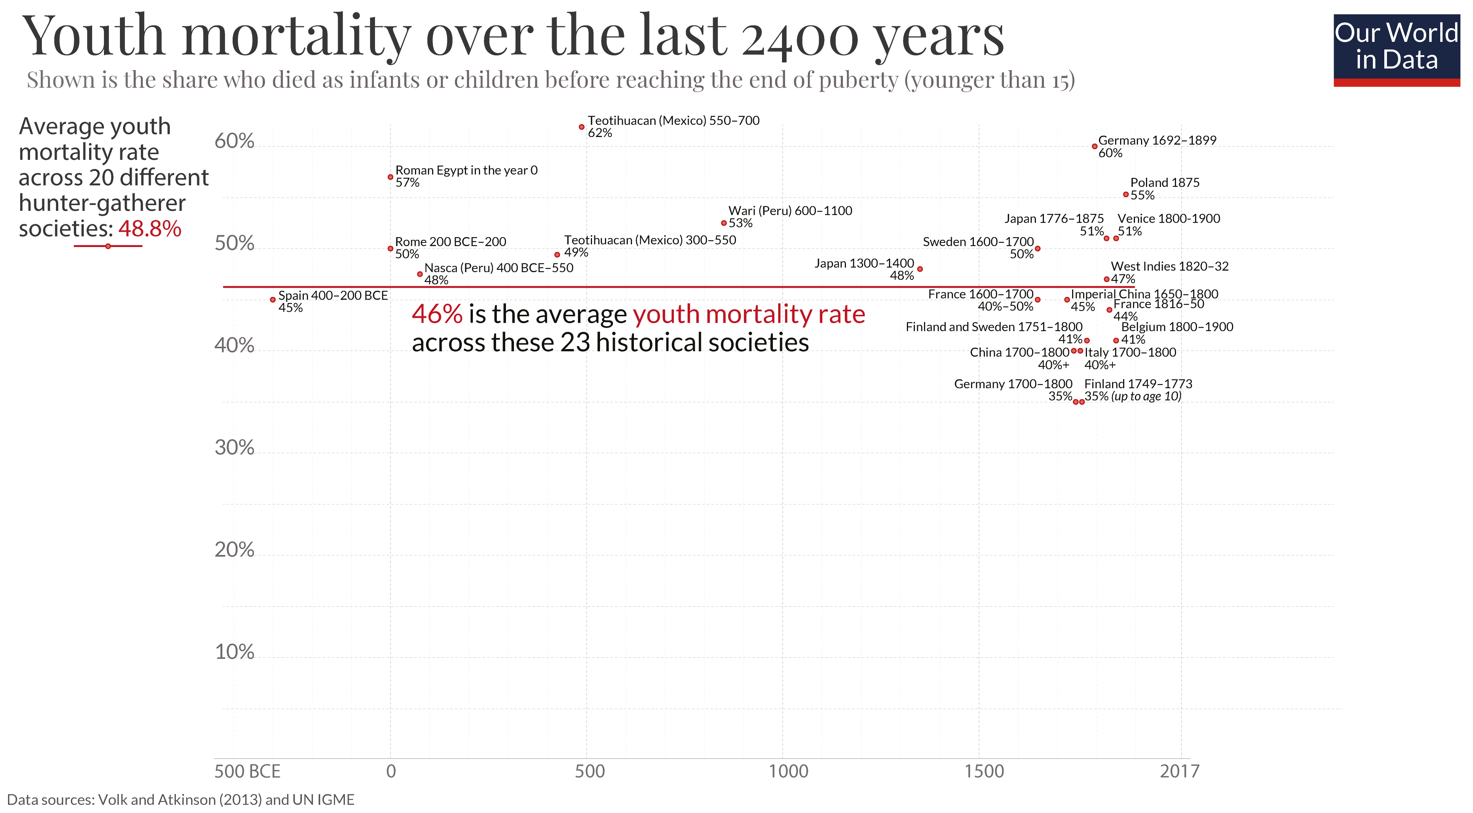

Slide 26
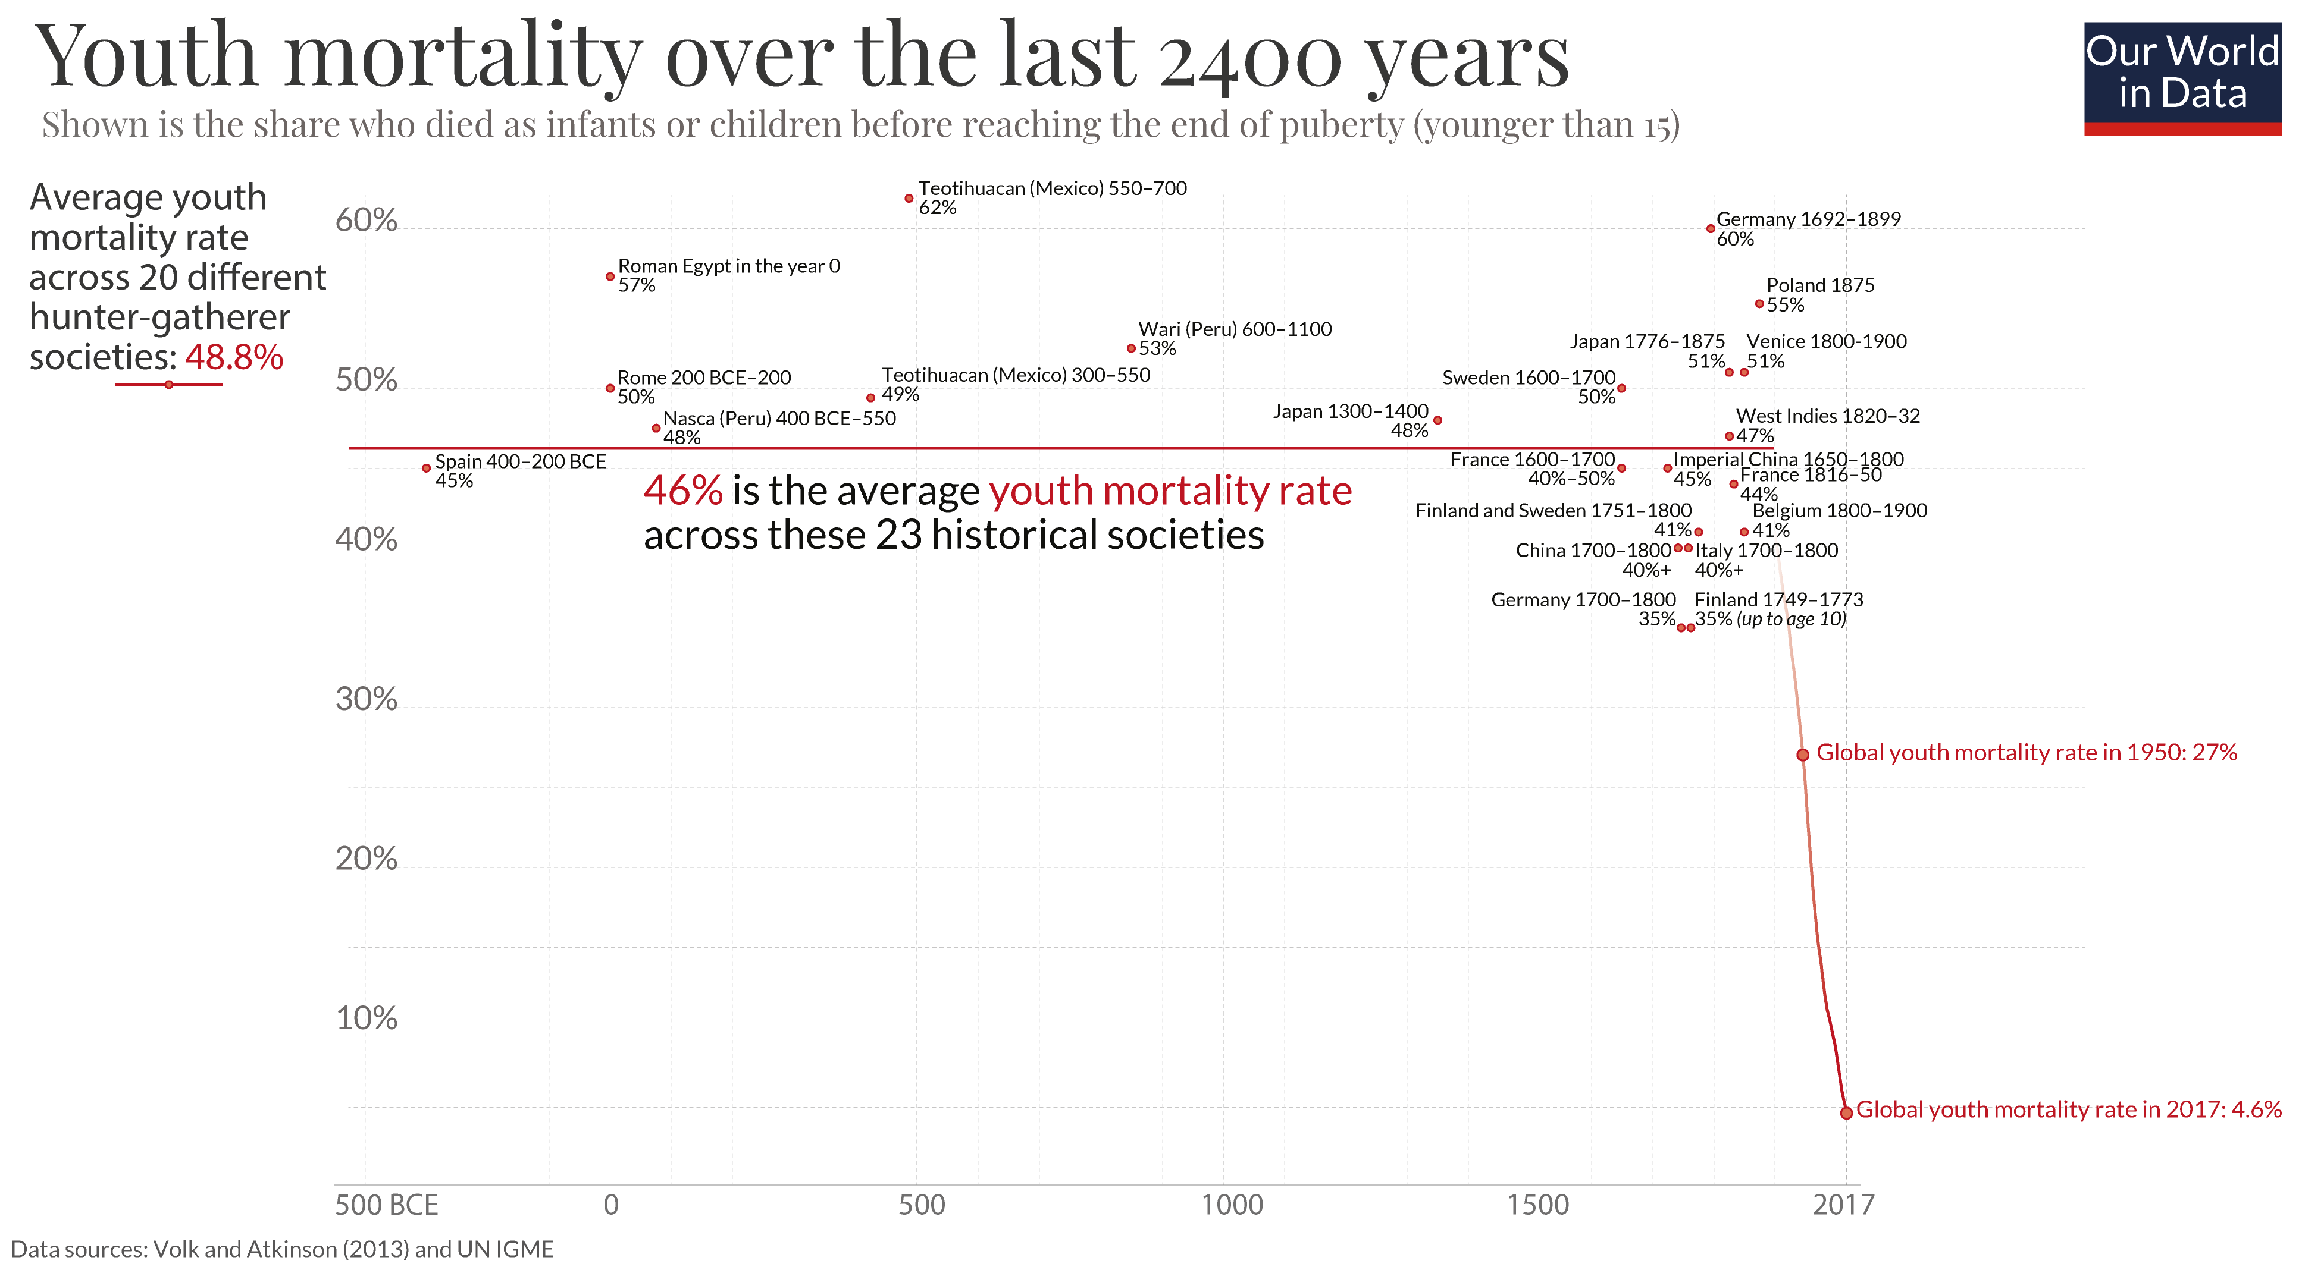

Slide 27
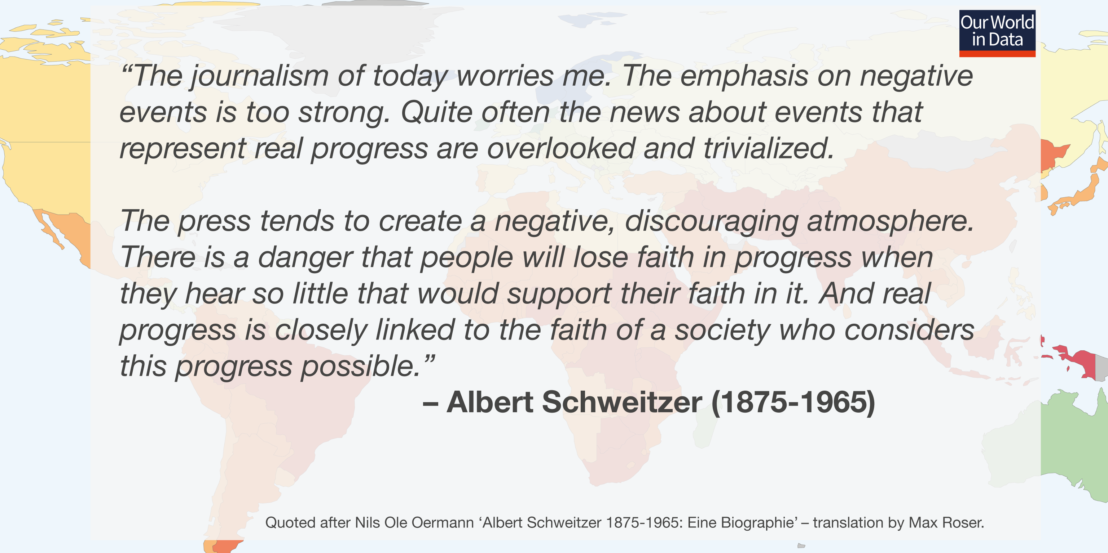

Slide 29
3] How can we make progress?

Slide 30
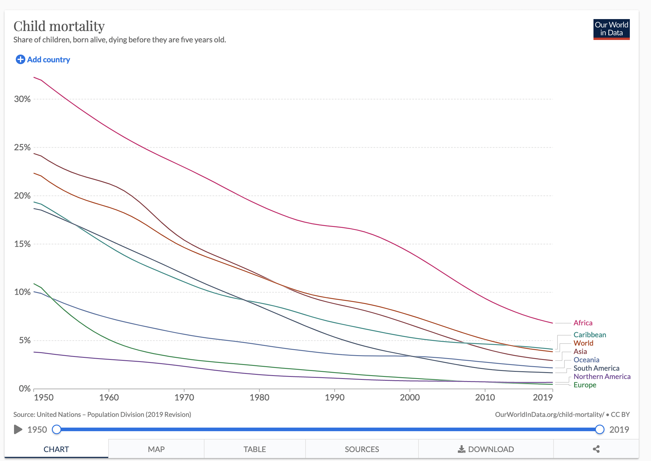
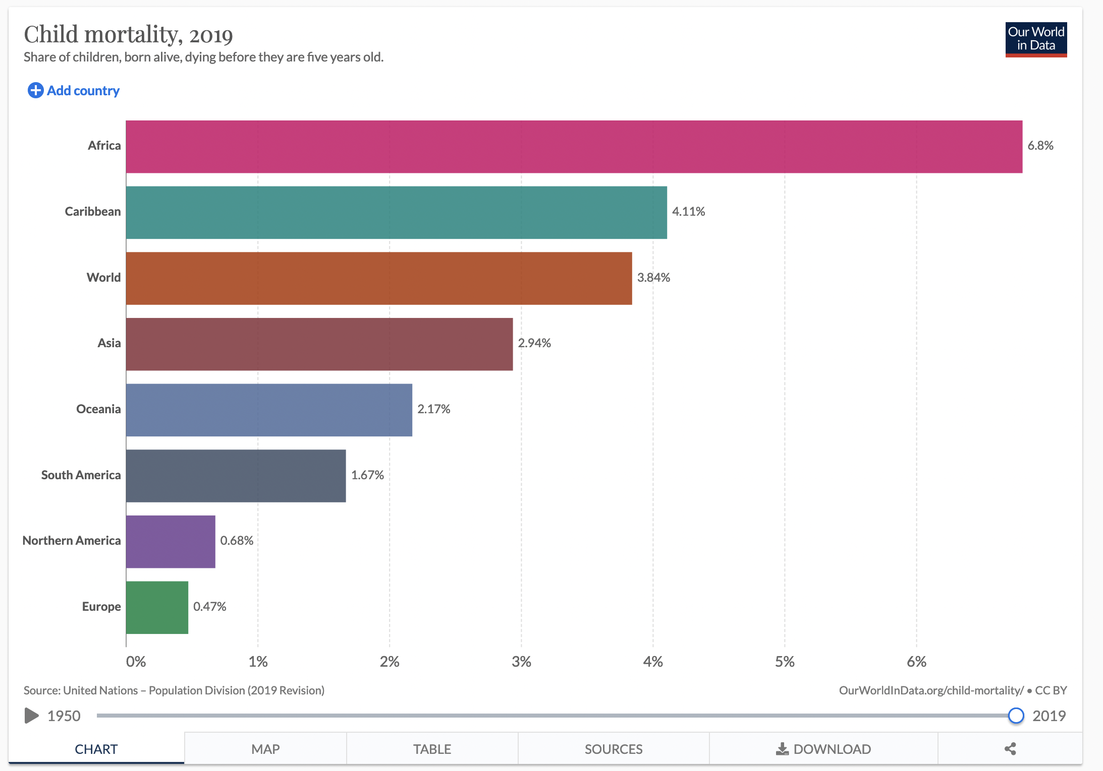

Slide 31
Three ways to make a difference in the world:
Your money
Your vote
Your career

Slide 32
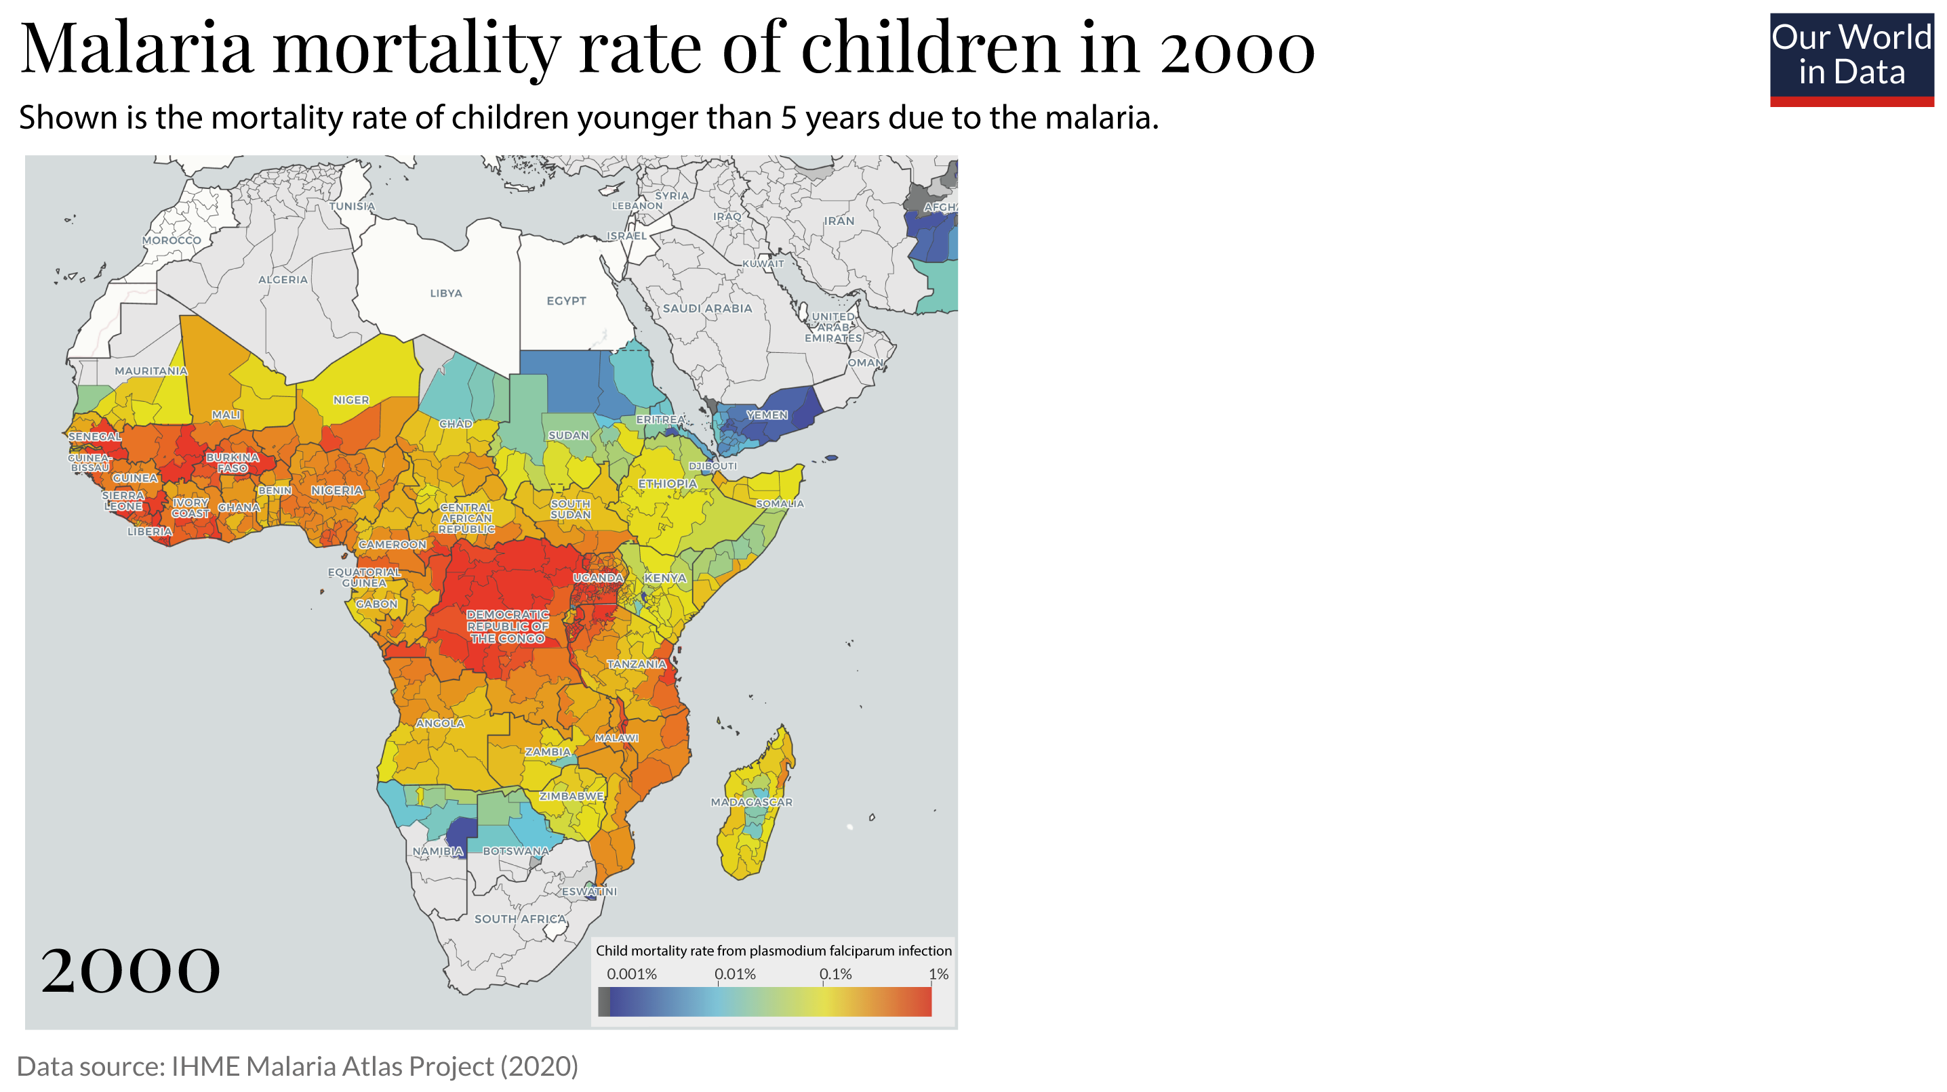
Your money

Slide 33
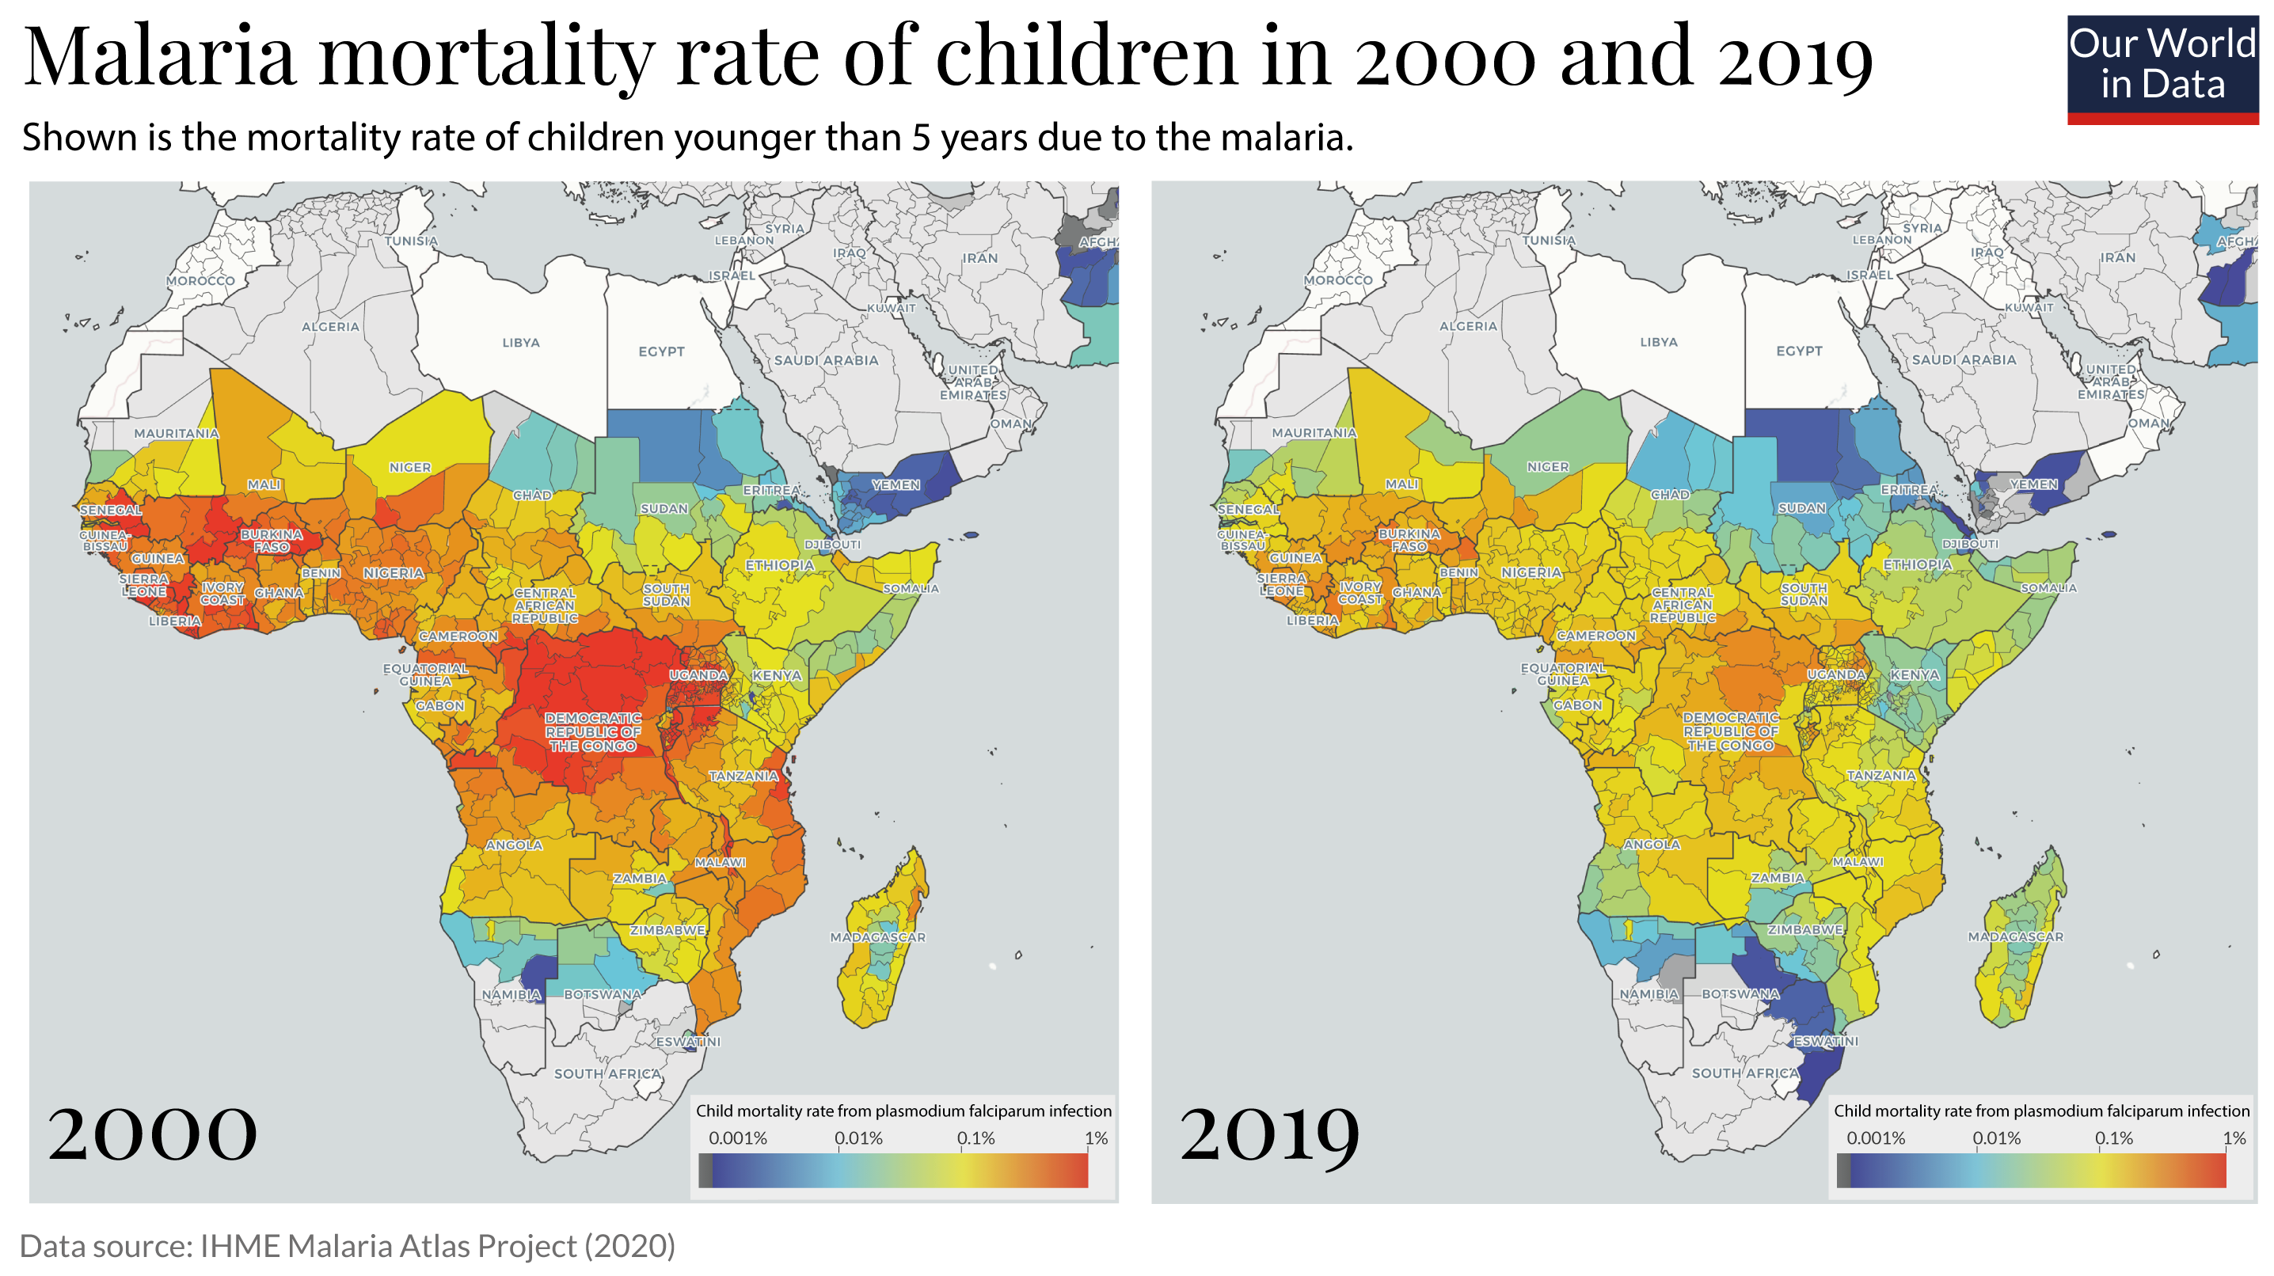
Your money

Slide 34
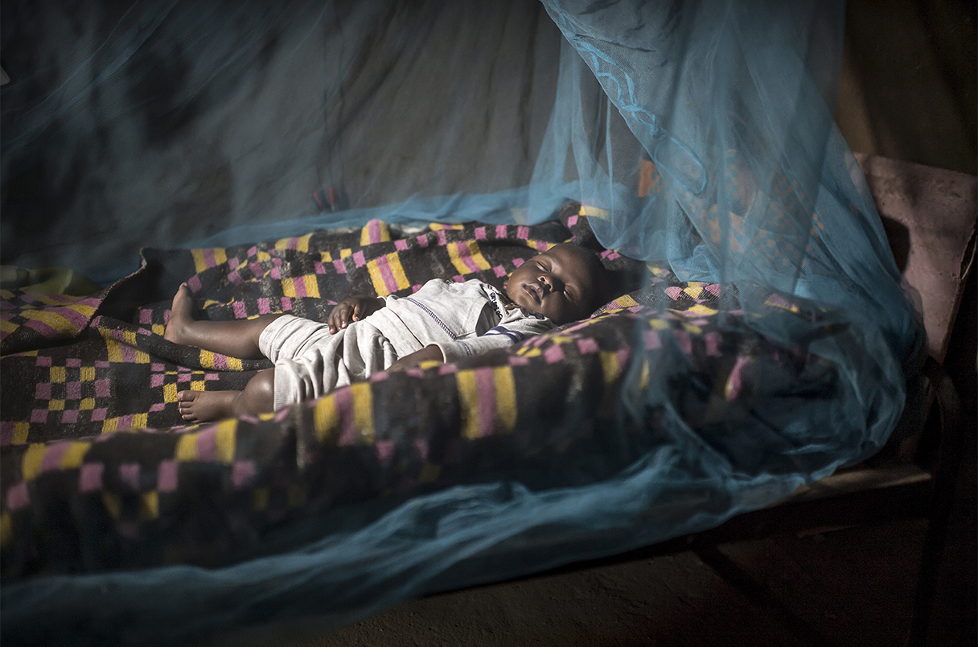
Bhatt et al. (2015) in Nature. 68% of averted cases due to bed-nets

Slide 35
The most important thing to know when it comes to donating your money: your money goes much further in some places than in others. People believe it’s 2-fold or so, but it is actually 100-fold.

Slide 36
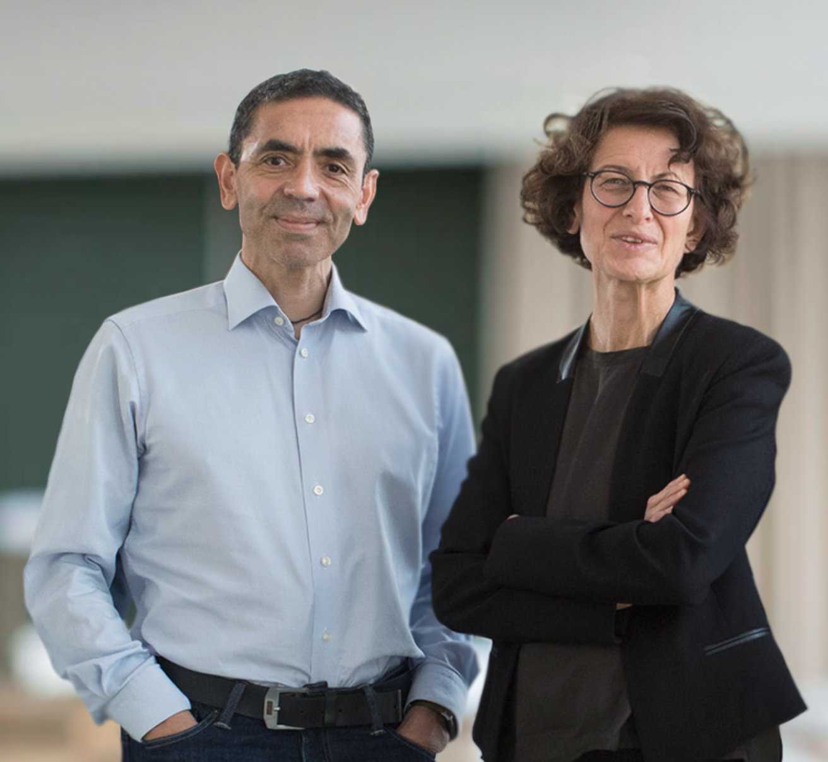
Your career: Who will develop the vaccine that brings the child deaths from malaria to an end?
Your political power: Who votes for the politicians who want to fund the vaccine development?

Slide 37
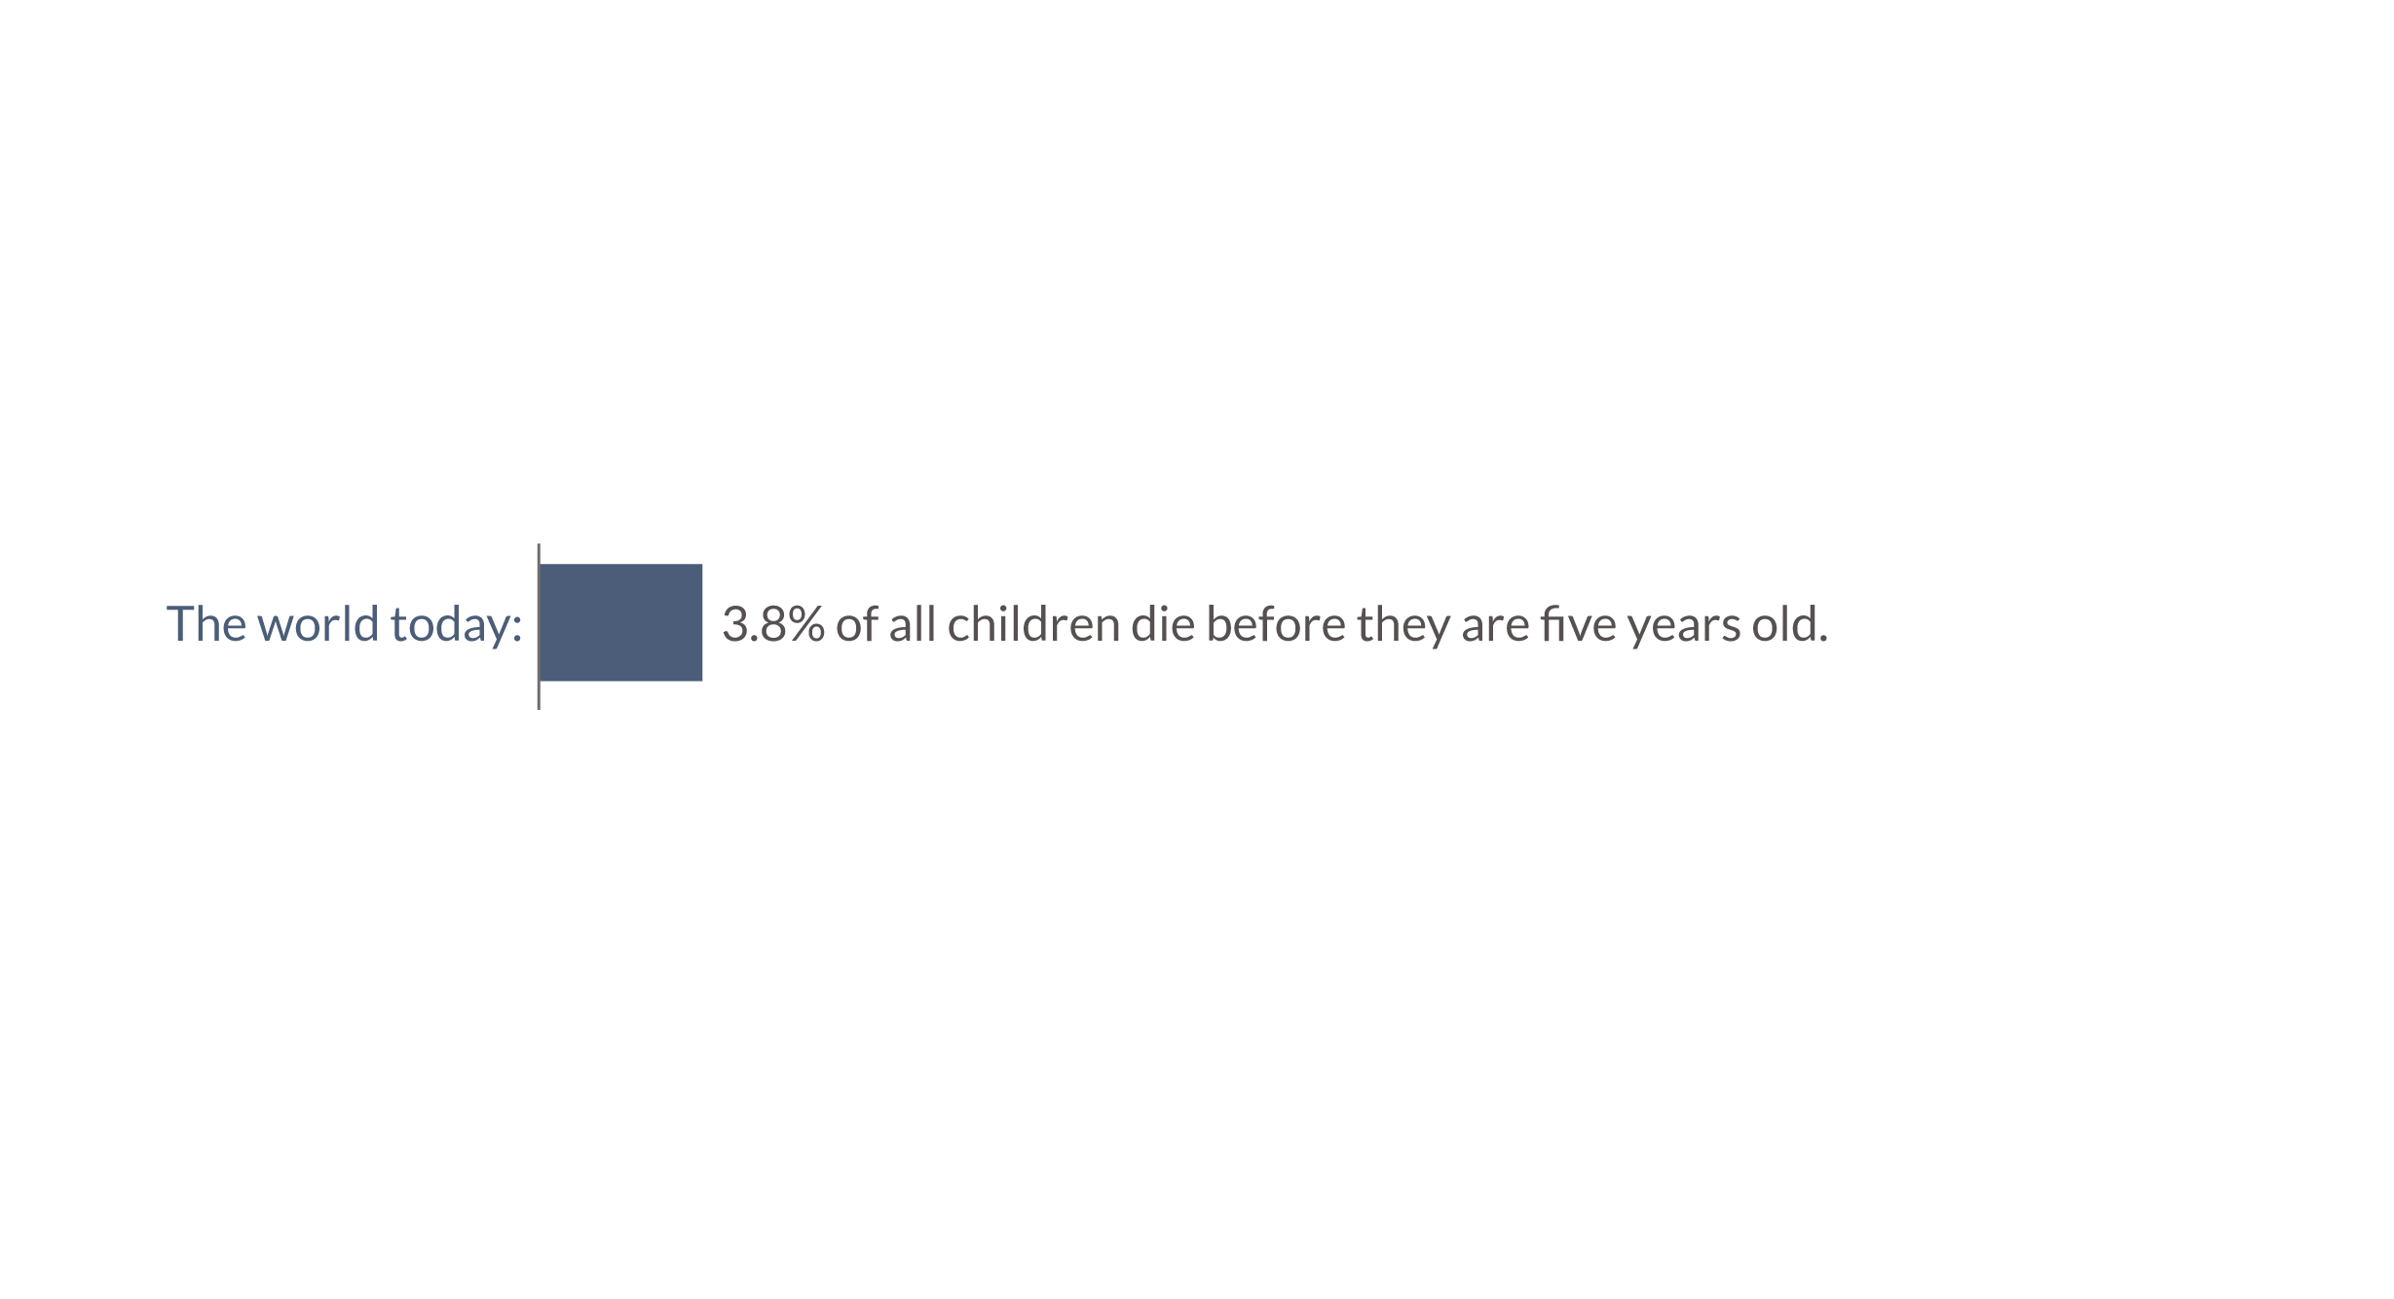

Slide 38
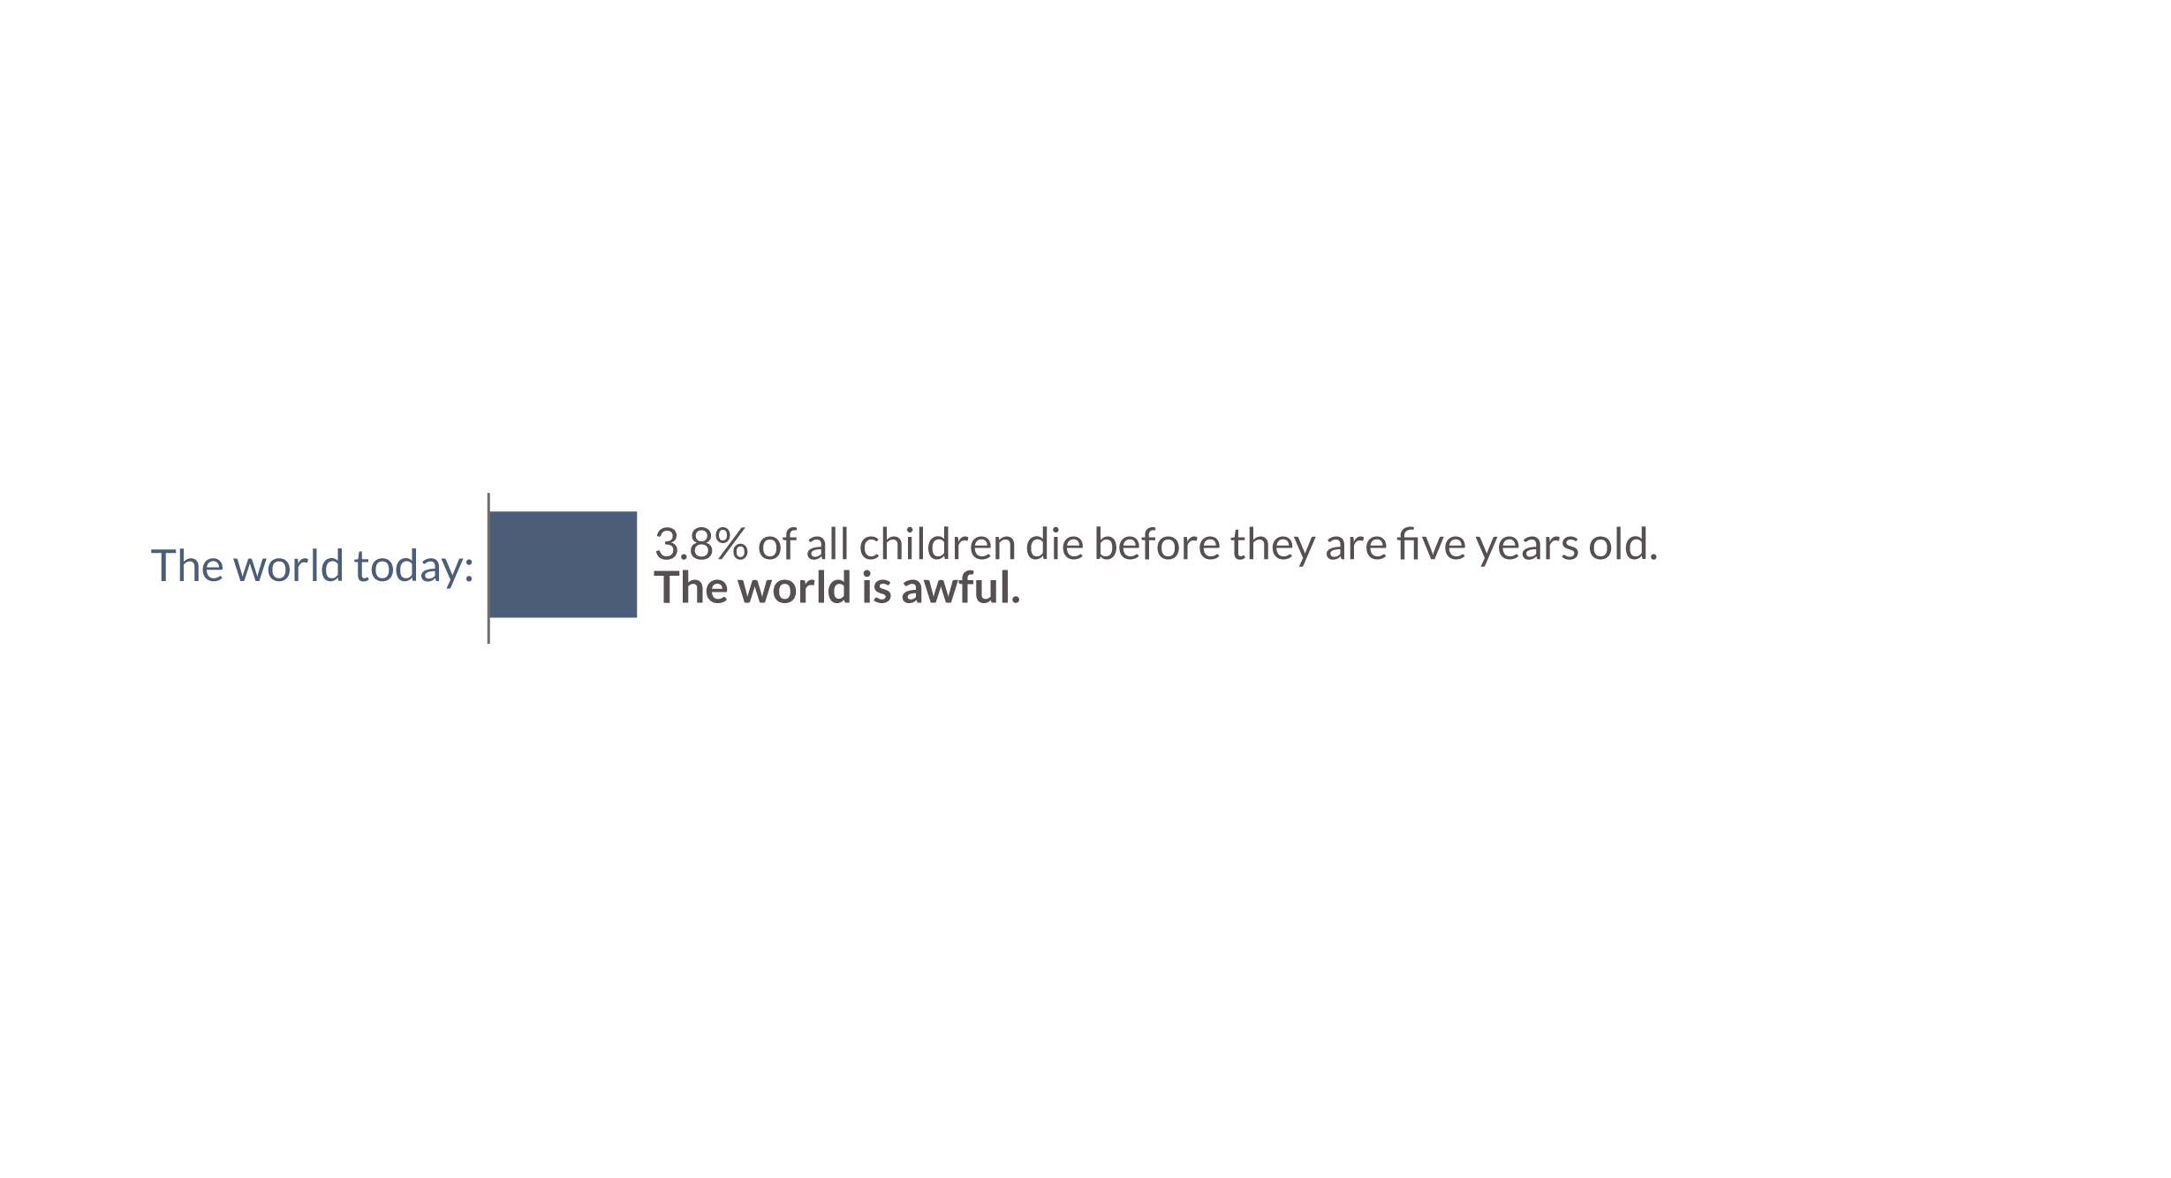

Slide 39
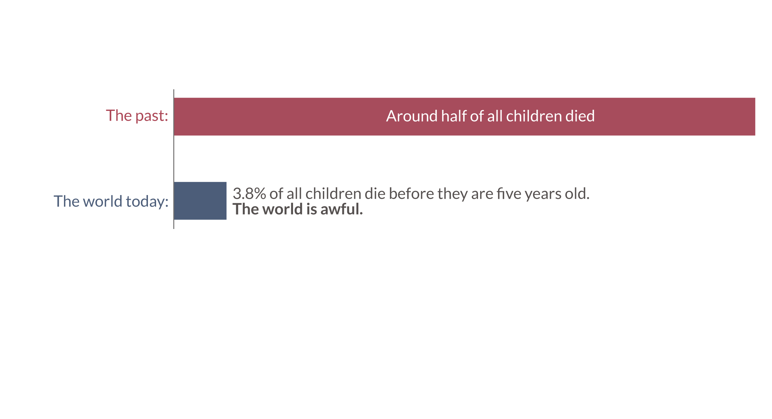

Slide 40
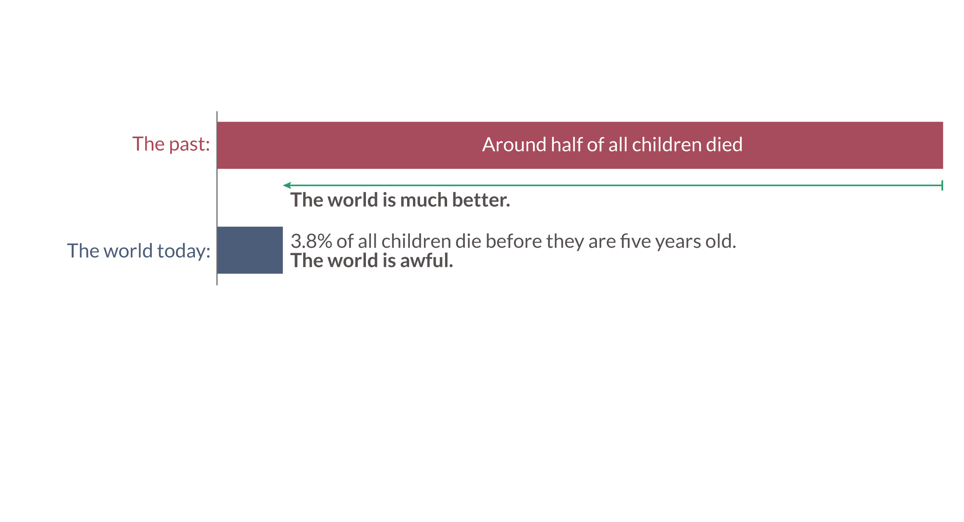

Slide 41


Slide 42


Slide 43
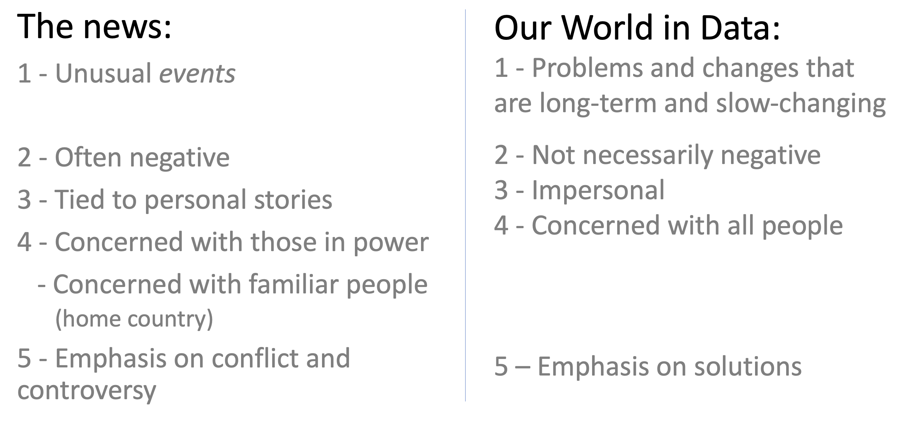

Slide 44
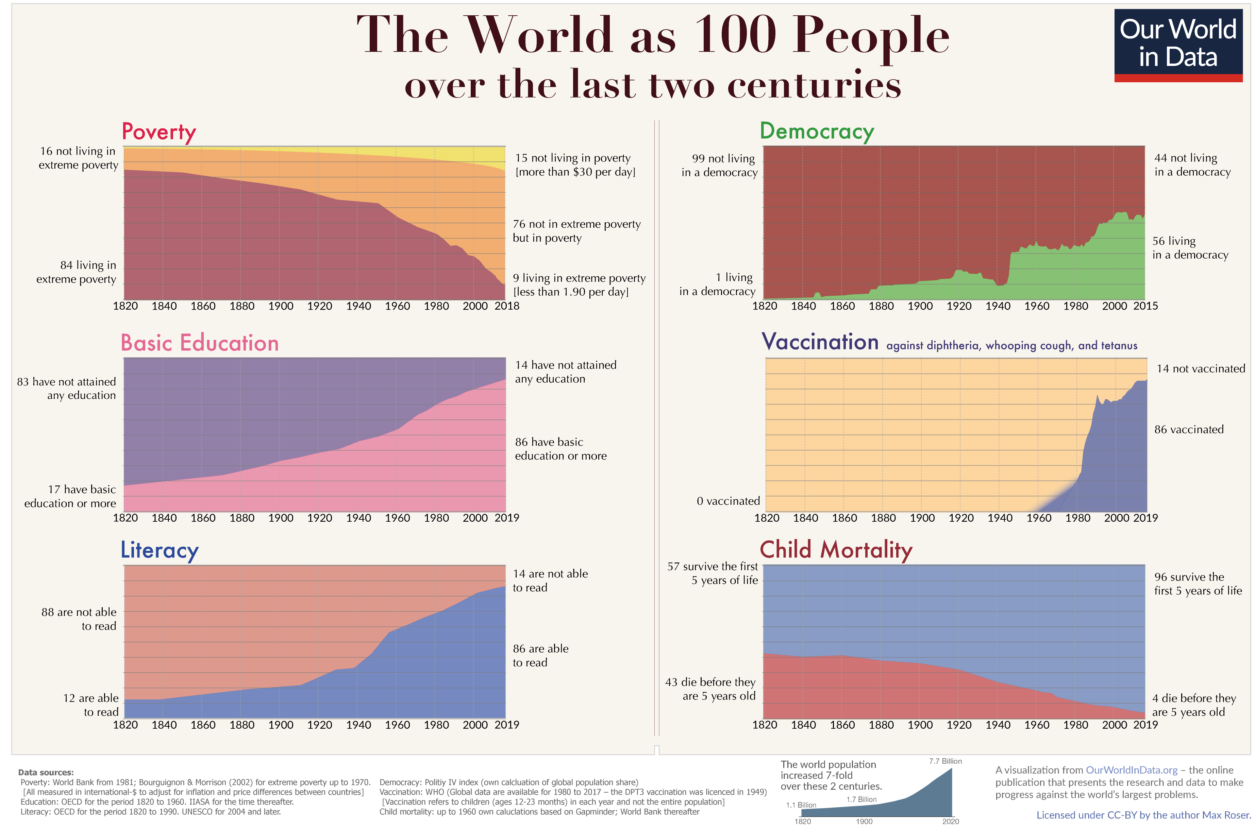

Slide 45
End

Slide 46
Global Problems of the Decade
This one shows the latest observations
Millions of newborns lost their mother in the moment they were born
Billions live in poverty
Every year 300,000 women die from pregnancy-related causes, this means that on any average day 830 mothers die
The majority of the world – 65% – lives on less than $10 per day.
And almost 10% live in ‘extreme poverty’, they live on less than $1.90 per day.
One in four lives in dictatorship
Millions grew up with the chance to go to school
Almost a quarter of the world population – 23% – live in autocratic regimes.
60 million children of primary school age are not in school.
World destroyed forests the size of Sweden
5.2 million children every year
The world deforested 47 million hectares of forest in the last decade, that’s an area the size of Sweden.
3.7% of all children die before they are five years old.

Slide 47
Global Problems of the Decade
This one shows the quickly estimated decadal averages or sums
Millions of newborns lost their mother in the moment they were born
Billions live in poverty
In the last decade 4 million women died from pregnancy-related causes.
Currently 830 mothers die on any average day.
The majority of the world – 65% – lives on less than $10 per day.
And almost 10% live in ‘extreme poverty’, they live on less than $1.90 per day.
One in four lives in dictatorship
Millions of children grew up with the chance to go to school
Almost a quarter of the world population – 23% – live in autocratic regimes.
60 million children of primary school age are not in school.
Hundreds of millions don’t have access to basic resources
700 million do not have access to clean drinking water, 1.1 billion don’t have access to electricity
World destroyed forests the size of Sweden
60 million children dead
The world deforested 47 million hectares of forest in the last decade, that’s an area the size of Sweden.
In the last decade 4.5% (or so) of all children died before they were five years old.

Slide 49
The world faces big problems
It is possible to make progress against big problems

Slide 50
There are three ways you can make a difference in the world:
Your career
(e.g. engineer, researcher, politician, activist, volunteer)
Your vote
(if you are lucky to live in a democratic country)
Your money
(purchases and donations)

Slide 51
To make good decisions you need to know the world.

Slide 52
How do we currently learn about the world?

Slide 53
The news
News-worthy is what is unusual
The news tells you about single events
The news focuses on personal stories
(tied to action of individual who causes the suffering or who is suffering)
The news focuses on bad news

Slide 54
The biggest mistake that newspapers make is to suggest that different things matter on different days.

Slide 55
What is not in the news?
I] Progress against big problems
– slow and powerful changes that reshape our world
II] Big problems
Exception are new problems
(the problem is in the word ‘news’)
Problems that have been around for a long time are not in the news – or only via ‘peg’
Poverty, Hunger, Early death, Agricultural impact on the environment

Slide 56
What do we need to know?
What is most important about the world:
1 – We have big problems
Which ones? What are they like?
2 – We can make progress
3 – How can we make progress?
What we need to know is that which is not in the news.
None of the three above can be known without data.
By far the biggest part of our work is describing what the problem is and giving an overview. What makes people see solutions is a clear description of the problem.

Slide 57
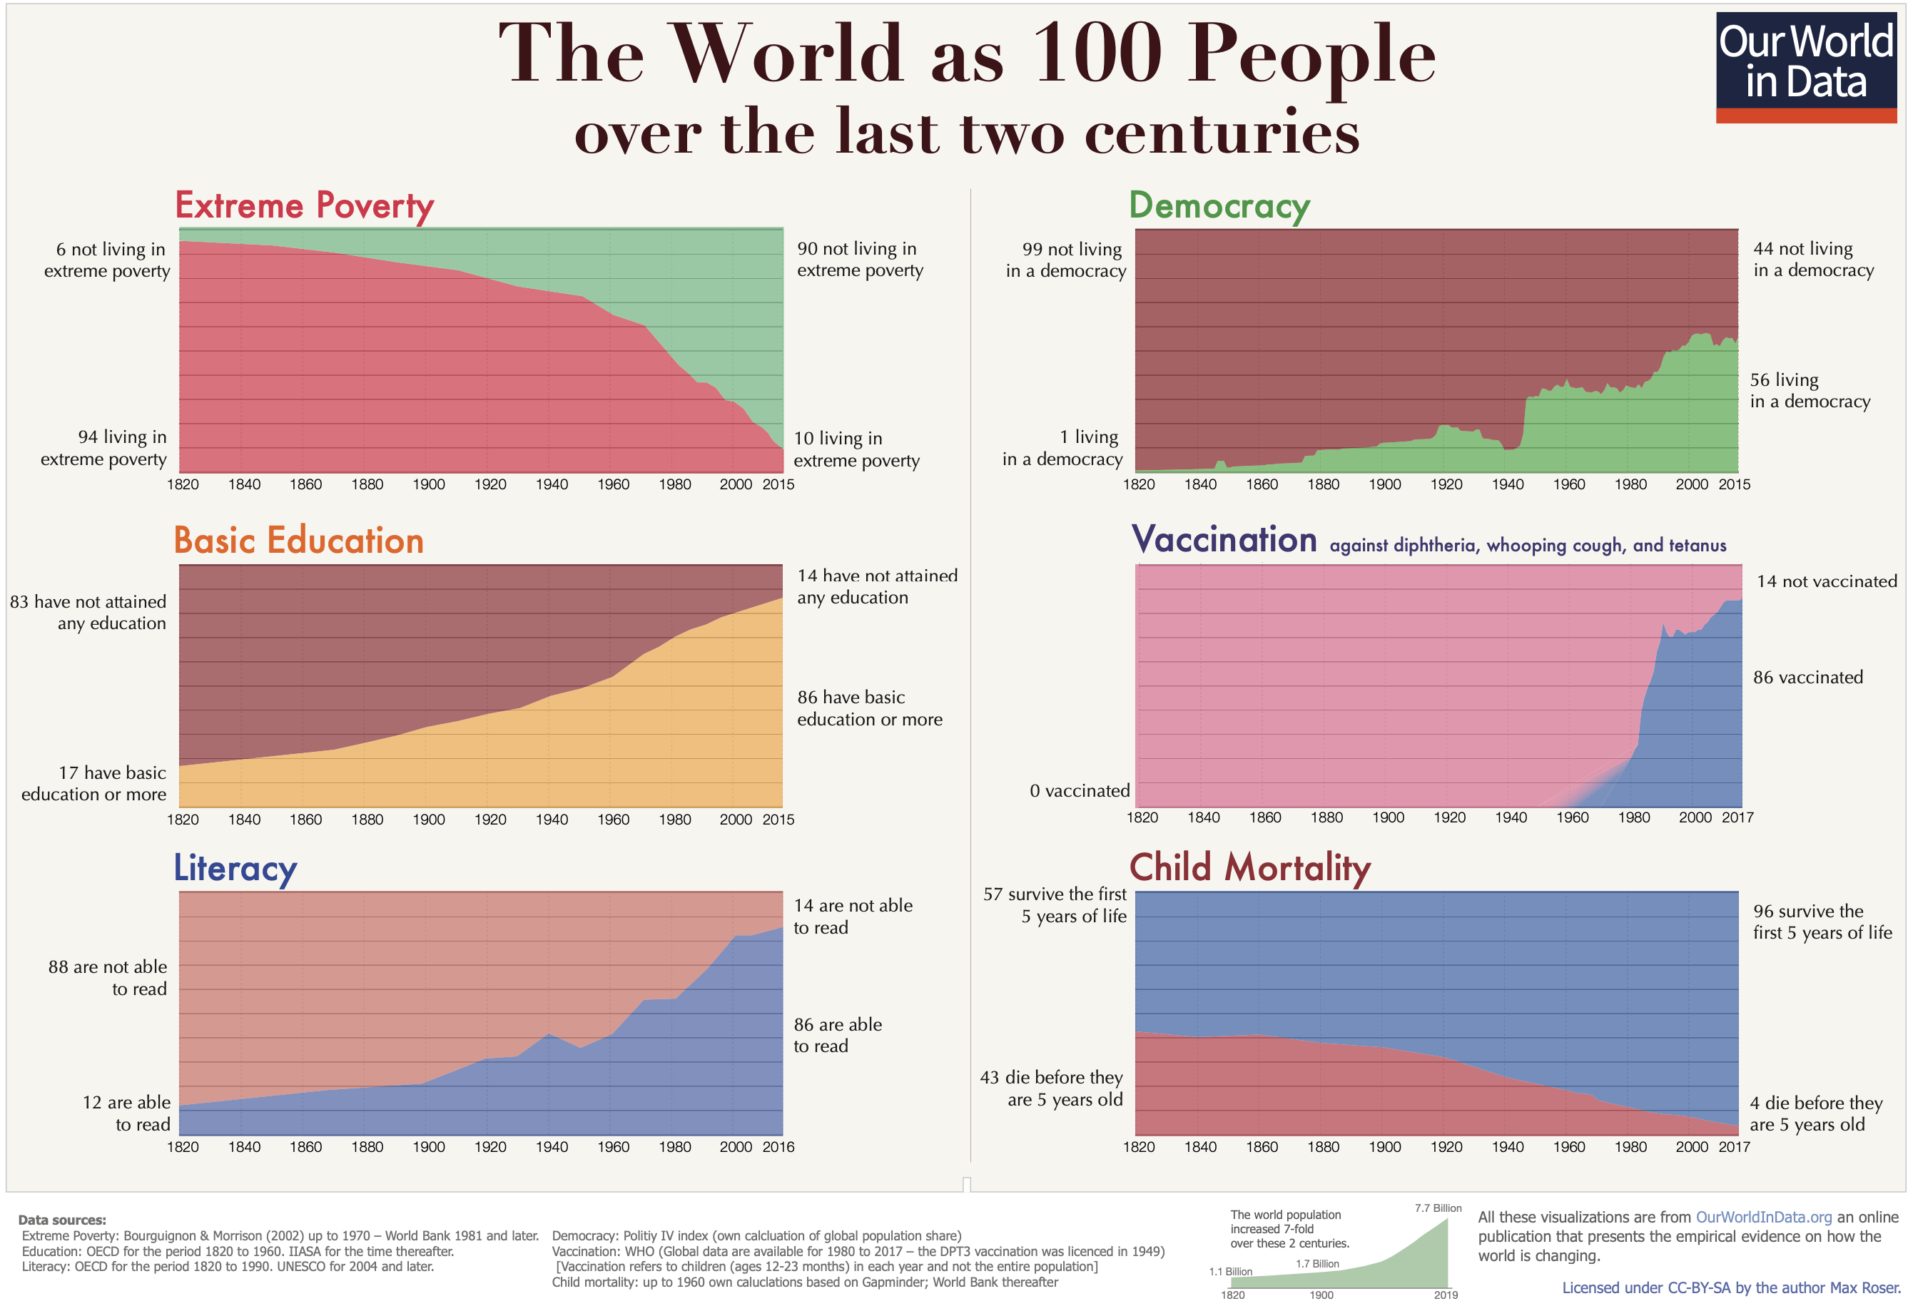
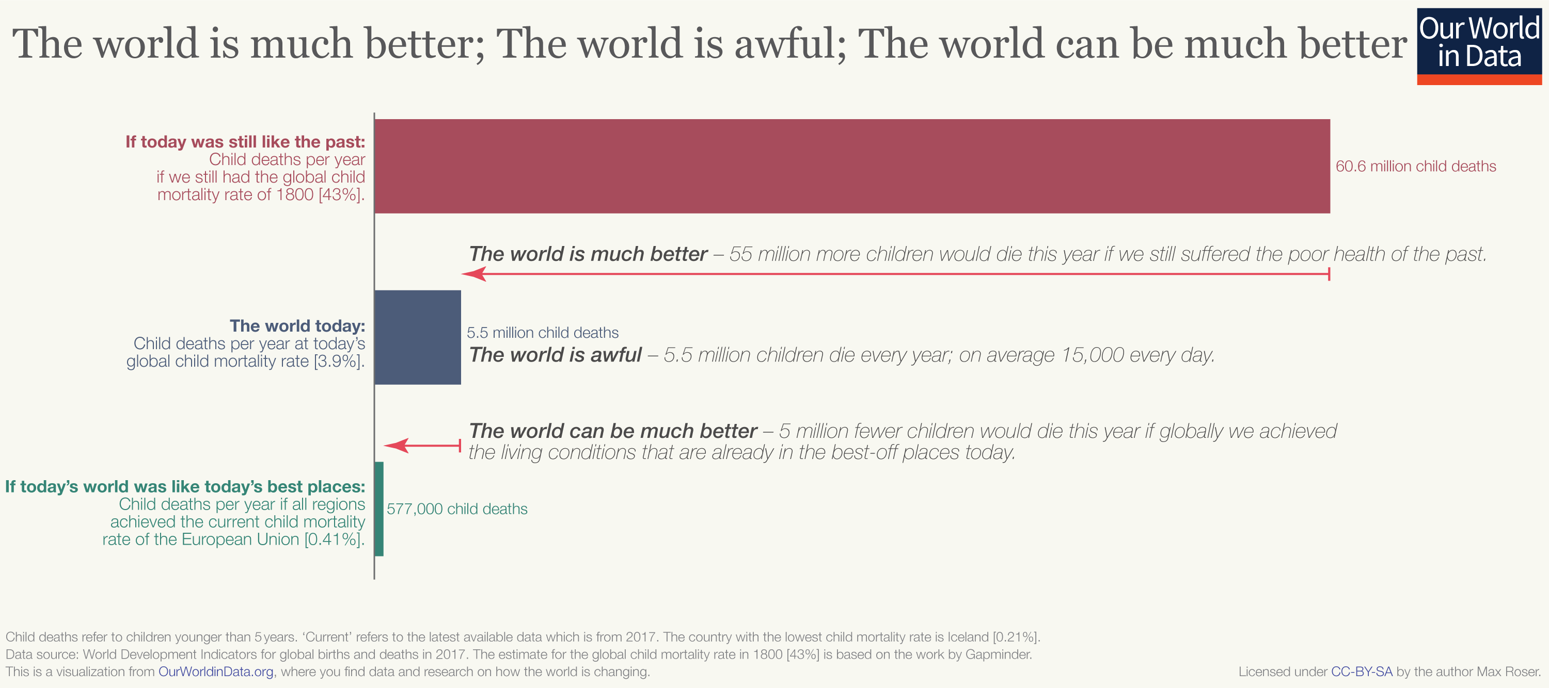
The content of The Our World in Data-Daily is our content. Three categories:
What the big problems are.
Frontpage
That we can make progress.
x
How we can make progress.
Our entries and posts
The world is better, awful, can be better
That
What
How

Slide 58
If you [OWID only: benefitted from progress in education , health,
and wealth and are very privileged person and you]
actually care about the big problems and don’t just want
to virtue signal but make a difference focus here
You can spend time on the news but
you should feel pretty bad about it
Original Max list from Feb
The news:
1 - Unusual events
2 - Often negative
3 - Tied to personal stories
4 - Concerned with those in power
- Concerned with familiar people
(home country)
5 - Emphasis on conflict and controversy
Our World in Data:
1 - Problems and changes that are long-term and slow-changing
2 - Not necessarily negative
3 - Impersonal
4 - Concerned with all people
5 – Emphasis on solutions

